Slide 1
Process management
What are we going to learn?
Processes : Concept of processes, process scheduling, co-operating processes, inter-process communication.
CPU scheduling : scheduling criteria, preemptive & non-preemptive scheduling, scheduling algorithms (FCFS, SJF, RR, priority), algorithm evaluation, multi-processor scheduling.
Process Synchronization : background, critical section problem, critical region, synchronization hardware, classical problems of synchronization, semaphores.
Threads : overview, benefits of threads, user and kernel threads.
Deadlocks : system model, deadlock characterization, methods for handling deadlocks, deadlock prevention, deadlock avoidance, deadlock detection, recovery from deadlock.

Slide 2

Process concept
Memory
Process is a dynamic entity
Program in execution
Program code
Contains the text section
Program becomes a process when
executable file is loaded in the memory
Allocation of various resources
Processor, register, memory, file, devices
One program code may create several processes
One user opened several MS Word
Equivalent code/text section
Other resources may vary
User program
Disk

Slide 3
Process State
As a process executes, it changes state
new: The process is being created
ready: The process is waiting to be assigned to a processor
running: Instructions are being executed
waiting: The process is waiting for some event to occur
terminated: The process has finished execution

Slide 4
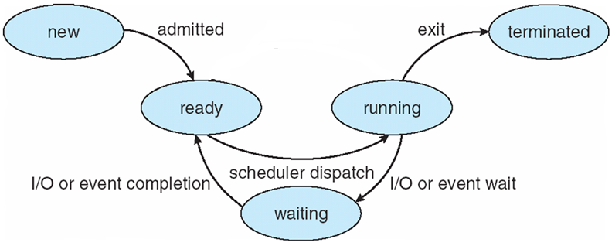
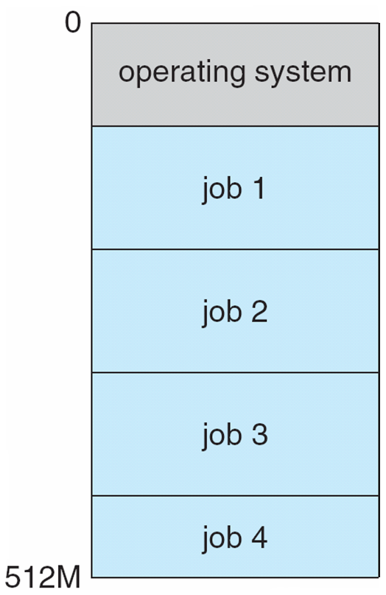

Process State diagram
Job pool
Single processor
Multiprogramming
As a process executes, it changes state
new: The process is being created
running: Instructions are being executed
waiting: The process is waiting for some event to occur
ready: The process is waiting to be assigned to a processor
terminated: The process has finished execution

Slide 5
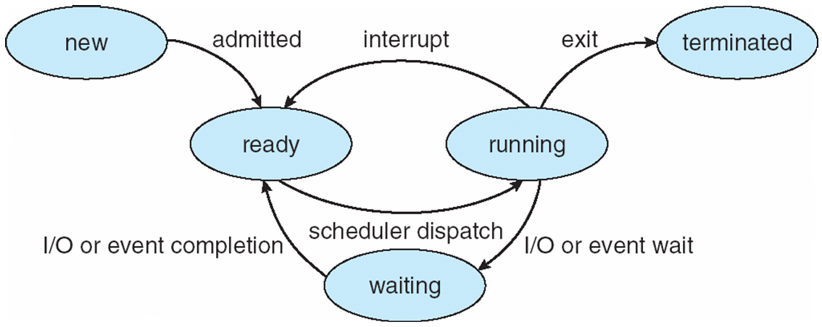
Process State diagram
Job pool
Multitasking/Time sharing
As a process executes, it changes state
new: The process is being created
running: Instructions are being executed
waiting: The process is waiting for some event to occur
ready: The process is waiting to be assigned to a processor
terminated: The process has finished execution

Slide 6
How to represent a process?
Process is a dynamic entity
Program in execution
Program code
Contains the text section
Program counter (PC)
Values of different registers
Stack pointer (SP) (maintains process stack)
Return address, Function parameters
Program status word (PSW)
General purpose registers
Main Memory allocation
Data section
Variables
Heap
Dynamic allocation of memory during process execution
C | Z | O | S | I | K

Slide 7
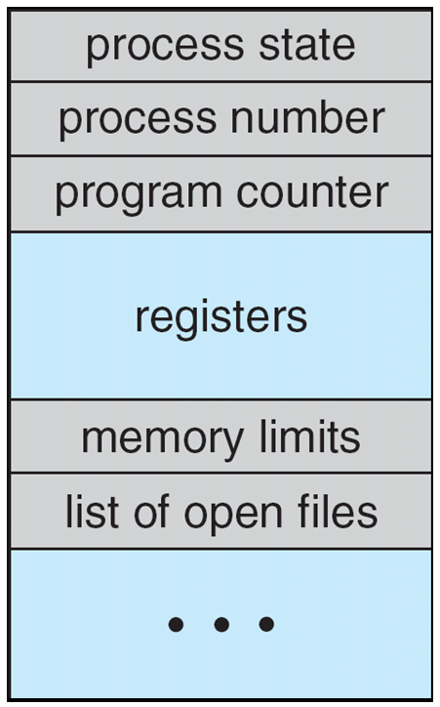
Process Control Block (PCB)
Process is represented in the operating system by a Process Control Block
Information associated with each process
Process state
Program counter
CPU registers
Accumulator, Index reg., stack pointer, general
Purpose reg., Program Status Word (PSW)
CPU scheduling information
Priority info, pointer to scheduling queue
Memory-management information
Memory information of a process
Base register, Limit register, page table, segment table
Accounting information
CPU usage time, Process ID, Time slice
I/O status information
List of open files=> file descriptors
Allocated devices

Slide 8
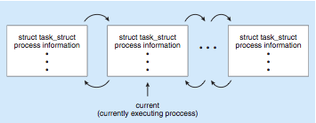
Process Representation in Linux
Represented by the C structure task_struct pid t pid; /* process identifier */ long state; /* state of the process */ unsigned int time slice /* scheduling information */ struct task struct *parent; /* this process’s parent */ struct list head children; /* this process’s children */ struct files struct *files; /* list of open files */ struct mm_struct *mm; /* address space of this pro */
Doubly linked list

Slide 9
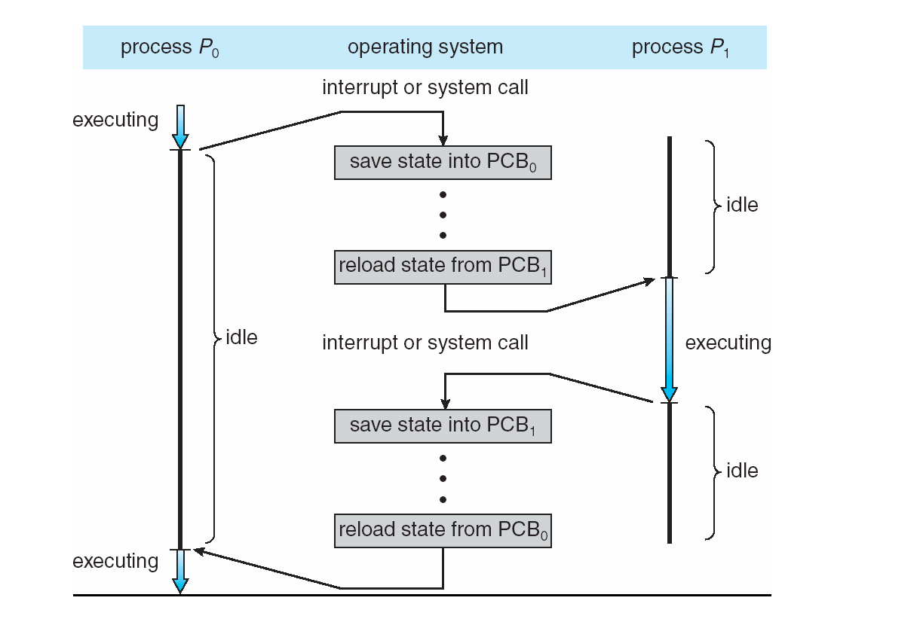
CPU Switch From Process to Process
Context switch

Slide 10
Context Switch
When CPU switches to another process, the system must save the state of the old process and load the saved state for the new process via a context switch.
Context of a process represented in the PCB
Context-switch time is overhead; the system does no do useful work while switching
The more complex the OS and the PCB -> longer the context switch
Time dependent on hardware support
Some hardware provides multiple sets of registers per CPU -> multiple contexts loaded at once

Slide 11
Scheduling queues
Maintains scheduling queues of processes
Job queue – set of all processes in the system
Ready queue – set of all processes residing in main memory, ready and waiting to execute
Device queues – set of processes waiting for an I/O device
Processes migrate among the various queues

Slide 12
Scheduling queues
Job queue
Ready queue
Device queue

Slide 13
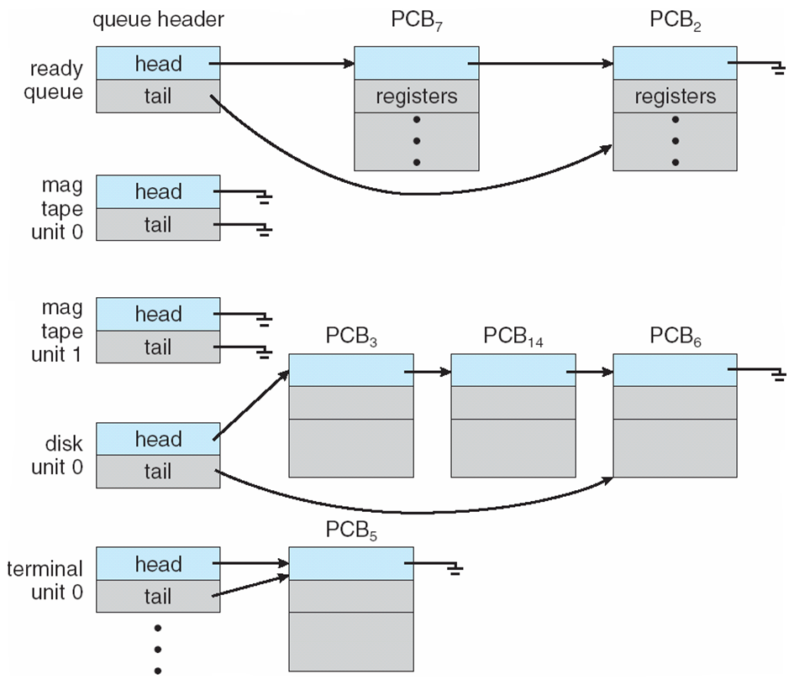
Ready Queue And Various I/O Device Queues
Queues are linked list of PCB’s
Device queue
Many processes are waiting for disk

Slide 14
Process Scheduling
We have various queues
Single processor system
Only one CPU=> only one running process
Selection of one process from a group of processes
Process scheduling

Slide 15
Process Scheduling
Scheduler
Selects a process from a set of processes
Two kinds of schedulers
1. Long term schedulers, job scheduler
A large number of processes are submitted (more than memory capacity)
Stored in disk
Long term scheduler selects process from job pool and loads in memory
2. Short term scheduler, CPU scheduler
Selects one process among the processes in the memory (ready queue)
Allocates to CPU

Slide 16
Long Term Scheduler
CPU scheduler

Slide 17
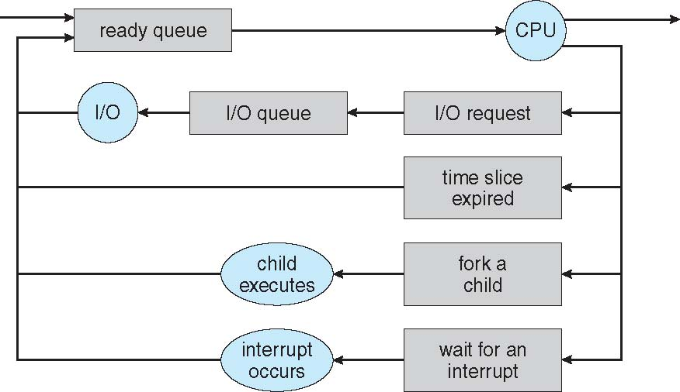
Representation of Process Scheduling
CPU scheduler selects a process
Dispatched (task of Dispatcher)
Parent at wait()

Slide 18
Dispatcher
Dispatcher module gives control of the CPU to the process selected by the short-term scheduler; this involves:
switching context
switching to user mode
jumping to the proper location in the user program to restart that program
Dispatch latency – time it takes for the dispatcher to stop one process and start another running

Slide 19
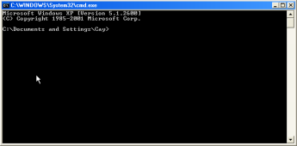
Creation of PCB
a.out
Shell
Create initial PCB
Child
Shell
Exce()
Loader (Loads program image in memory)
Update PCB
Context switch
Insert in ready queue
Allocate CPU

Slide 20
Schedulers
Scheduler
Selects a process from a set
Long-term scheduler (or job scheduler) – selects which processes should be brought into the ready queue
Short-term scheduler (or CPU scheduler) – selects which process should be executed next and allocates CPU
Sometimes the only scheduler in a system

Slide 21
Schedulers: frequency of execution
Short-term scheduler is invoked very frequently (milliseconds) ⇒ (must be fast)
After a I/O request/ Interrupt
Long-term scheduler is invoked very infrequently (seconds, minutes) ⇒ (may be slow)
The long-term scheduler controls the degree of multiprogramming
Processes can be described as either:
I/O-bound process – spends more time doing I/O than computations, many short CPU bursts
Ready queue empty
CPU-bound process – spends more time doing computations; few very long CPU bursts
Devices unused
Long term scheduler ensures good process mix of I/O and CPU bound processes.

Slide 22
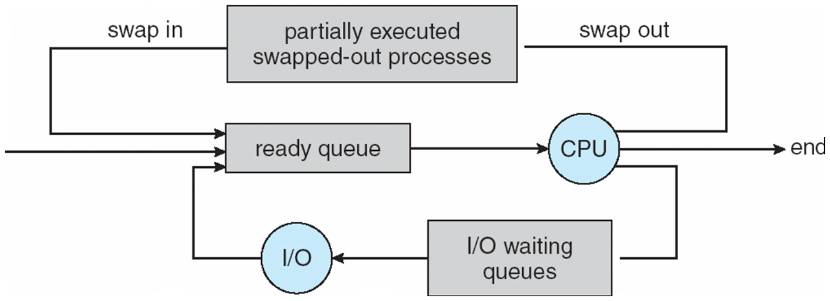
Addition of Medium Term Scheduling
disk
Swap Space
Swapper

Slide 23
ISR for context switch
Current <- PCB of current process
Context_switch()
{
switch to kernel mode
Disable interrupt;
Save_PCB(current);
Insert(ready_queue, current);
next=CPU_Scheduler(ready_queue);
remove(ready_queue, next);
Enable Interrupt;
Dispatcher(next);
}
Dispatcher(next)
{
Load_PCB(next); [update PC]
switch to user mode;
}

Slide 25
CPU Scheduling
Describe various CPU-scheduling algorithms
Evaluation criteria for selecting a CPU-scheduling algorithm for a particular system

Slide 26
Basic Concepts
Maximum CPU utilization obtained with multiprogramming
Several processes in memory (ready queue)
When one process requests I/O, some other process gets the CPU
Select (schedule) a process and allocate CPU

Slide 27
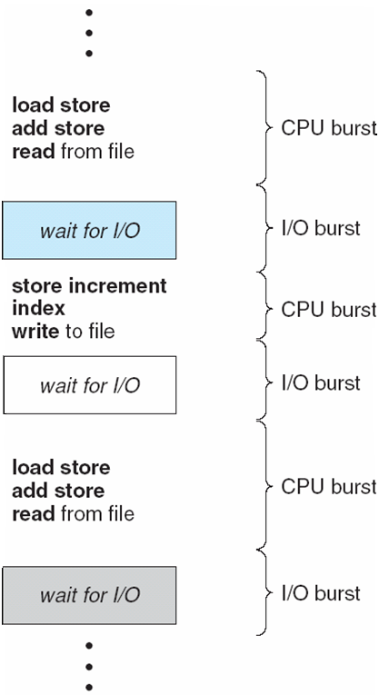
Observed properties of Processes
CPU–I/O Burst Cycle
Process execution consists of a cycle of CPU execution and I/O wait
Study the duration of CPU bursts

Slide 28
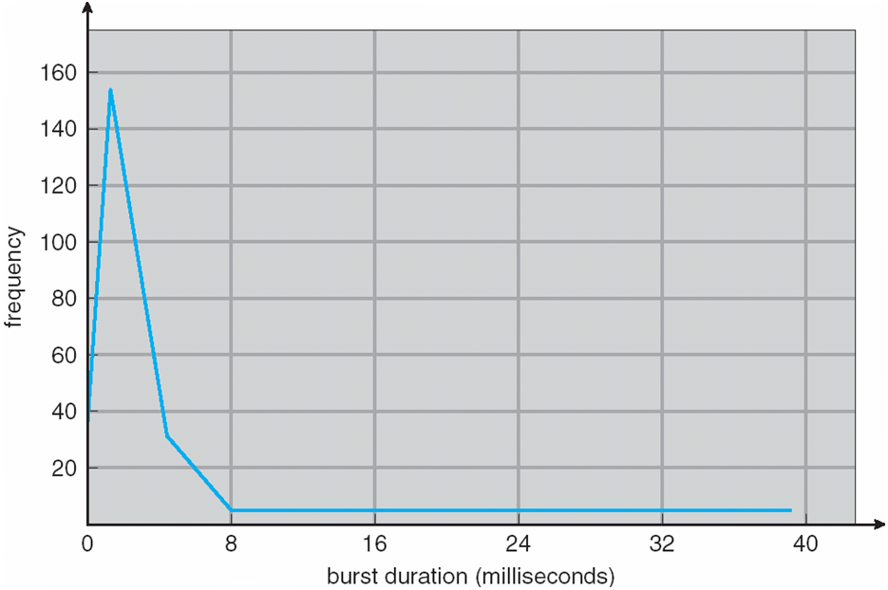
Histogram of CPU-burst Times
Utility of CPU scheduler
CPU bound process
I/O bound process
Large number of short CPU bursts and small number of long CPU bursts

Slide 29
Preemptive and non preemptive
Selects from among the processes in ready queue, and allocates the CPU to one of them
Queue may be ordered in various ways (not necessarily FIFO)
CPU scheduling decisions may take place when a process:
1. Switches from running to waiting state
2. Switches from running to ready state
3. Switches from waiting to ready
Terminates
Scheduling under 1 and 4 is nonpreemptive
All other scheduling is preemptive

Slide 30
Long Term Scheduler
CPU scheduler

Slide 31
Preemptive scheduling
Preemptive scheduling
Results in cooperative processes
Issues:
Consider access to shared data
Process synchronization
Consider preemption while in kernel mode
Updating the ready or device queue
Preempted and running a “ps -el”

Slide 32
Scheduling Criteria
CPU utilization – keep the CPU as busy as possible
Throughput – # of processes that complete their execution per time unit
Turnaround time – amount of time to execute a particular process
Waiting time – amount of time a process has been waiting in the ready queue
Response time – amount of time it takes from when a request was submitted until the first response is produced, not output

Slide 33
Scheduling Algorithm Optimization Criteria
Max CPU utilization
Max throughput
Min turnaround time
Min waiting time
Min response time
Mostly optimize the average
Sometimes optimize the minimum or maximum value
Minimize max response time
For interactive system, variance is important
E.g. response time
System must behave in predictable way

Slide 34
Scheduling algorithms
First-Come, First-Served (FCFS) Scheduling
Shortest-Job-First (SJF) Scheduling
Priority Scheduling
Round Robin (RR)

Slide 35
First-Come, First-Served (FCFS) Scheduling
Process that requests CPU first, is allocated the CPU first
Ready queue=>FIFO queue
Non preemptive
Simple to implement
Performance evaluation
Ideally many processes with several CPU and I/O bursts
Here we consider only one CPU burst per process

Slide 36
First-Come, First-Served (FCFS) Scheduling
Process Burst Time
P₁ 24
P₂ 3
P₃ 3
Suppose that the processes arrive in the order: P₁ , P₂ , P₃ The Gantt Chart for the schedule is:
Waiting time for P₁ = 0; P₂ = 24; P₃ = 27
Average waiting time: (0 + 24 + 27)/3 = 17
P₁
P₂
P₃
0
24
27
30

Slide 37
FCFS Scheduling (Cont.)
Suppose that the processes arrive in the order:
P₂ , P₃ , P₁
The Gantt chart for the schedule is:
Waiting time for P₁ = 6; P₂ = 0; P₃ = 3
Average waiting time: (6 + 0 + 3)/3 = 3
Much better than previous case
Average waiting time under FCFS heavily depends on process arrival time and burst time
Convoy effect - short process behind long process
Consider one CPU-bound and many I/O-bound processes
P₂
P₃
P₁
0
3
6
30

Slide 38
Shortest-Job-First (SJF) Scheduling
Associate with each process the length of its next CPU burst
Allocate CPU to a process with the smallest next CPU burst.
Not on the total CPU time
Tie=>FCFS

Slide 39
Example of SJF
ProcessArriva l Time Burst Time
P₁ 0.0 6
P₂ 2.0 8
P₃ 4.0 7
P₄ 5.0 3
SJF scheduling chart
Average waiting time = (3 + 16 + 9 + 0) / 4 = 7
P₄
P₁
P₃
P₂
0
3
9
16
24
Avg waiting time for FCFS?

Slide 40
SJF
SJF is optimal – gives minimum average waiting time for a given set of processes (Proof: home work!)
The difficulty is knowing the length of the next CPU request
Useful for Long term scheduler
Batch system
Could ask the user to estimate
Too low value may result in “time-limit-exceeded error”

Slide 41
Preemptive version Shortest-remaining-time-first
Preemptive version called shortest-remaining-time-first
Concepts of varying arrival times and preemption to the analysis
ProcessA arri Arrival TimeT Burst Time
P₁ 0 8
P₂ 1 4
P₃ 2 9
P₄ 3 5
Preemptive SJF Gantt Chart
Average waiting time = [(10-1)+(1-1)+(17-2)+(5-3)]/4 = 26/4 = 6.5 msec
P₁
P₂
P₄
P₁
P₃
0
1
5
10
17
26
Avg waiting time for non preemptive?

Slide 42
Determining Length of Next CPU Burst
Estimation of the CPU burst length – should be similar to the previous burst
Then pick process with shortest predicted next CPU burst
Estimation can be done by using the length of previous CPU bursts, using time series analysis
Commonly, α set to ½
Boundary cases α=0, 1

Slide 43
Examples of Exponential Averaging
α =0
τ_{n+1} = τ_{n}
Recent burst time does not count
α =1
τ_{n+1} = t_{n}
Only the actual last CPU burst counts
If we expand the formula, we get:
τ_{n+1} = α t_{n}+(1 - α)α t_{n-1} + …
+(1 - α )^{j} α t_{n} _{-j} + …
+(1 - α )^{n +1} τ₀
Since both α and (1 - α) are less than or equal to 1, each successive term has less weight than its predecessor

Slide 44
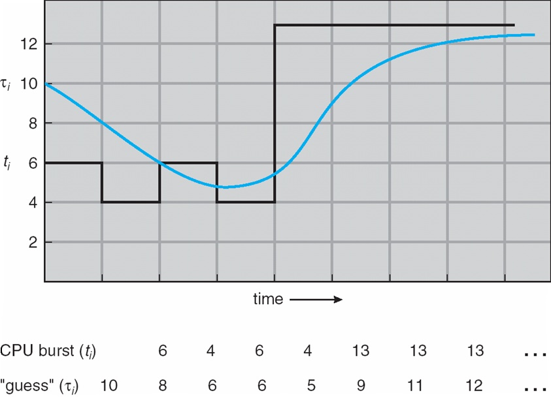
Prediction of the Length of the Next CPU Burst
0
1
2
3
6

Slide 45
Priority Scheduling
A priority number (integer) is associated with each process
The CPU is allocated to the process with the highest priority (smallest integer ≡ highest priority)
Set priority value
Internal (time limit, memory req., ratio of I/O Vs CPU burst)
External (importance, fund etc)
SJF is priority scheduling where priority is the inverse of predicted next CPU burst time
Two types
Preemptive
Nonpreemptive
Problem ≡ Starvation – low priority processes may never execute
Solution ≡ Aging – as time progresses increase the priority of the process
nice

Slide 46
Example of Priority Scheduling
ProcessA arri Burst TimeT Priority
P₁ 10 3
P₂ 1 1
P₃ 2 4
P₄ 1 5
P₅ 5 2
Priority scheduling Gantt Chart
Average waiting time = 8.2 msec
P₂
P₅
P₁
P₃
P₄
0
1
6
16
18
19

Slide 47
Round Robin (RR)
Designed for time sharing system
Each process gets a small unit of CPU time (time quantum q), usually 10-100 milliseconds.
After this time has elapsed, the process is preempted and added to the end of the ready queue.
Implementation
Ready queue as FIFO queue
CPU scheduler picks the first process from the ready queue
Sets the timer for 1 time quantum
Invokes despatcher
If CPU burst time < quantum
Process releases CPU
Else Interrupt
Context switch
Add the process at the tail of the ready queue
Select the front process of the ready queue and allocate CPU

Slide 48
Example of RR with Time Quantum = 4
Process Burst Time
P₁ 24
P₂ 3
P₃ 3
The Gantt chart is:
Avg waiting time = ((10-4)+4+7)/3=5.66
P₁
P₂
P₃
P₁
P₁
P₁
P₁
P₁
0
4
7
10
14
18
22
26
30

Slide 49
Round Robin (RR)
Each process has a time quantum T allotted to it
Dispatcher starts process P₀, loads a external counter (timer) with counts to count down from T to 0
When the timer expires, the CPU is interrupted
The context switch ISR gets invoked
The context switch saves the context of P₀
PCB of P₀ tells where to save
The scheduler selects P₁ from ready queue
The PCB of P₁ tells where the old state, if any, is saved
The dispatcher loads the context of P₁
The dispatcher reloads the counter (timer) with T
The ISR returns, restarting P₁ (since P₁’s PC is now loaded as part of the new context loaded)
P₁ starts running

Slide 50
Round Robin (RR)
If there are n processes in the ready queue and the time quantum is q
then each process gets 1/n of the CPU time in chunks of at most q time units at once.
No process waits more than (n-1)q time units.
Timer interrupts every quantum to schedule next process
Performance depends on time quantum q
q large ⇒ FIFO
q small ⇒ Processor sharing (n processes has own CPU running at 1/n speed)

Slide 51
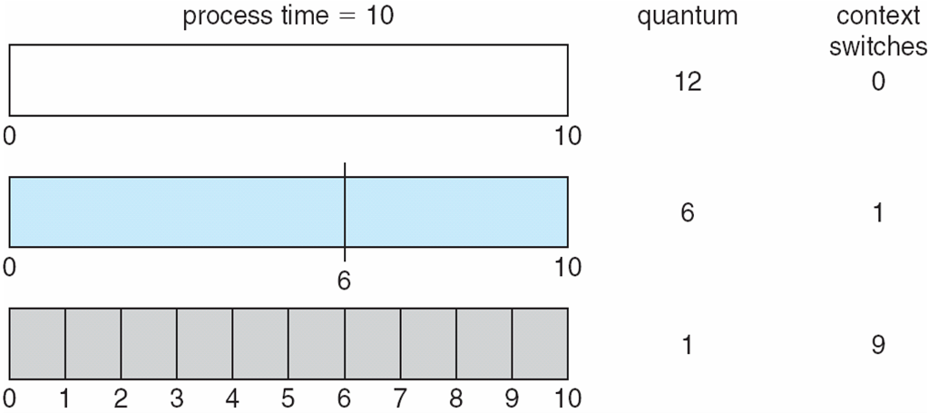
Effect of Time Quantum and Context Switch Time
Performance of RR scheduling
No overhead
However, poor response time
Too much overhead!
Slowing the execution time
q must be large with respect to context switch, otherwise overhead is too high
q usually 10ms to 100ms, context switch < 10 microsec

Slide 52
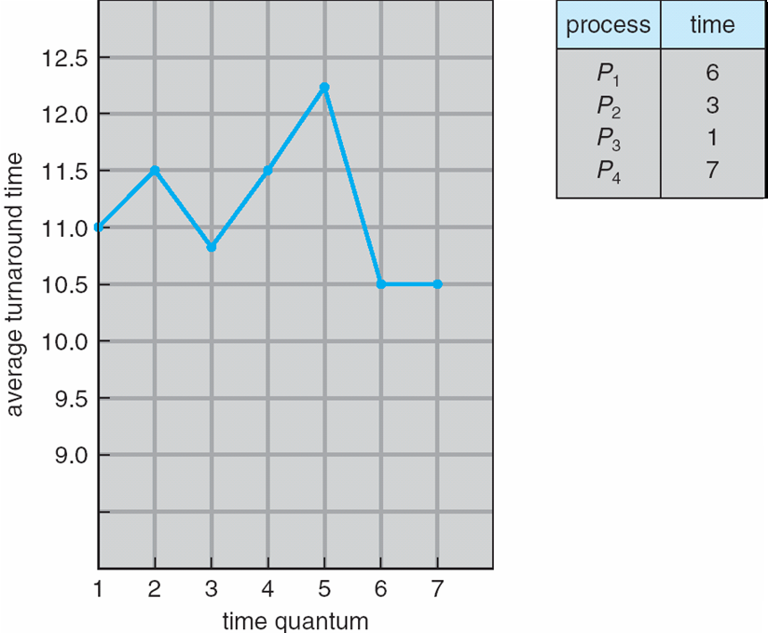
Effect on Turnaround Time
TT depends on the time quantum and CPU burst time
Better if most processes complete there next CPU burst in a single q
Large q=> processes in ready queue suffer
Small q=> Completion will take more time
80% of CPU bursts should be shorter than q
Response time
Typically, higher average turnaround than SJF, but better response time

Slide 53
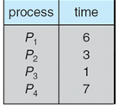
Turnaround Time
q=1
0
1
2
3
4
5
6
7
8
9
10
11
12
13
14
15
16
17
P1 | P2 | P3 | P4 | P1 | P2 | P4 | P1` | P2 | P4 | P1 | P4 | P1 | P4 | P1 | P4 | P4
Avg Turnaround time= (15+9+3+17)/4=11
0
6
9
10
16
17
P1 | P2 | P3 | P4 | P4
q=6
(6+9+10+17)/4=10.5

Slide 54
Process classification
Foreground process
Interactive
Frequent I/O request
Requires low response time
Background Process
Less interactive
Like batch process
Allows high response time
Can use different scheduling algorithms for two types of processes ?

Slide 55
Multilevel Queue
Ready queue is partitioned into separate queues, eg:
foreground (interactive)
background (batch)
Process permanently assigned in a given queue
Based on process type, priority, memory req.
Each queue has its own scheduling algorithm:
foreground – RR
background – FCFS
Scheduling must be done between the queues:
Fixed priority scheduling; (i.e., serve all from foreground then from background).
Possibility of starvation.

Slide 56
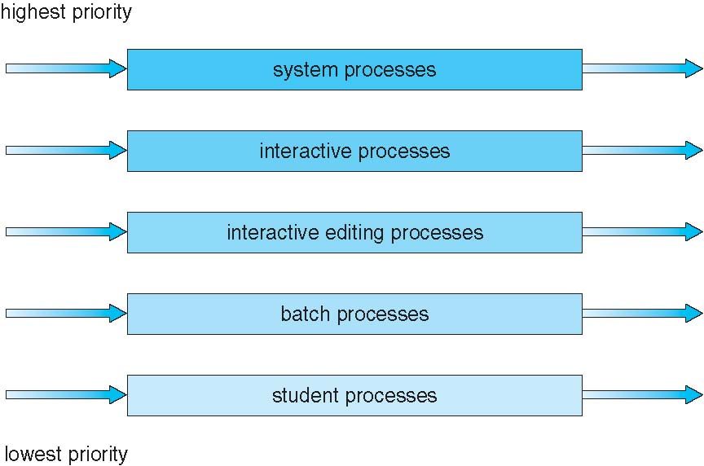
Multilevel Queue Scheduling
No process in batch queue could run unless upper queues are empty
If new process enters
Preempt
Another possibility
Time slice – each queue gets a certain amount of CPU time which it can schedule amongst its processes; i.e., 80% to foreground in RR
20% to background in FCFS

Slide 57
Multilevel Feedback Queue
So a process is permanently assigned a queue when they enter in the system
They do not move
Flexibility!
Multilevel-feedback-queue scheduling
A process can move between the various queues;
Separate processes based of the CPU bursts
Process using too much CPU time can be moved to lower priority
Interactive process => Higher priority
Move process from low to high priority
Implement aging

Slide 58
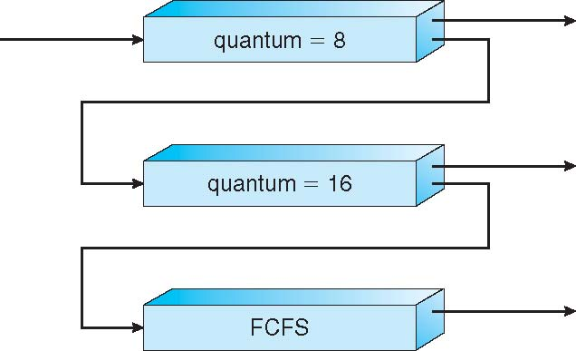
Example of Multilevel Feedback Queue
Q₀
Three queues:
Q₀ – RR with time quantum 8 milliseconds
Q₁ – RR time quantum 16 milliseconds
Q₂ – FCFS
Scheduling
A new job enters queue Q₀
When it gains CPU, job receives 8 milliseconds
If it does not finish in 8 milliseconds, job is moved to queue Q₁
At Q₁ job is again receives 16 milliseconds
If it still does not complete, it is preempted and moved to queue Q₂
Q₁
Q₂

Slide 59
Multilevel Feedback Queues
Highest Priority to processes CPU burst time <8 ms
Then processes >8 and <24

Slide 60
Multilevel-feedback-queue scheduler defined by the following parameters:
number of queues
scheduling algorithms for each queue
method used to determine when to upgrade a process
method used to determine when to demote a process
method used to determine which queue a process will enter when that process needs service

Slide 61
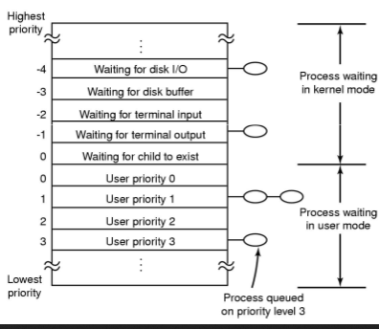
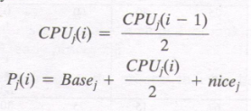
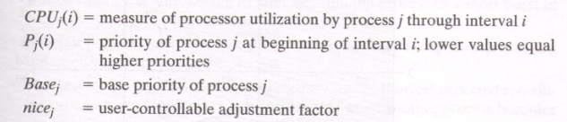
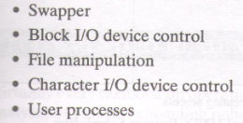
Unix scheduling
Time_critical, Highest, Above_Normal, normal, Below_Normal
Lowest, Idle

Slide 62
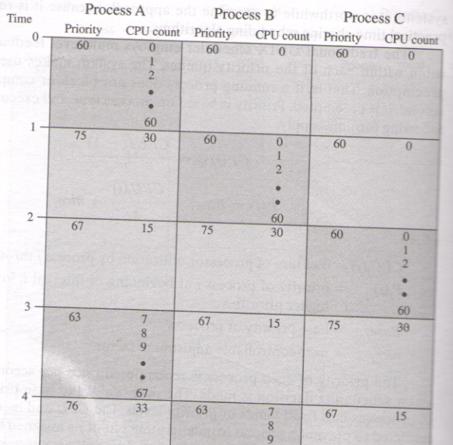
Unix scheduling

Slide 63
Linux scheduler
Pre-emptive, priority based scheduling
Linux version | Scheduler
Linux pre 2.5 | Multilevel Feedback Queue
Linux 2.5-2.6.23 | O(1) scheduler
Linux post 2.6.23 | Completely Fair Scheduler
We will be talking about the O(1) scheduler

Slide 64
Runqueue in 2.4 and 2.6 versions
List of all runnable processes
2.4 Kernel
2.6 Kernel
CPU1
CPU2
CPU3
CPU1
CPU2
CPU3

Slide 65
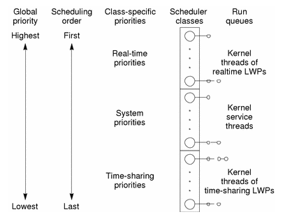
Linux Scheduling
3 scheduling classes
SCHED_FIFO and SCHED_RR are real-time classes
SCHED_OTHER is for the rest
140 Priority levels
0-99 : RT priority
100-139 : User task priorities
Three different scheduling policies
One for normal tasks
Two for Real time tasks

Slide 66
Real-Time Policies
First-in, first-out: SCHED_FIFO
Static priority
Process is only preempted for a higher-priority process
No time quanta; it runs until it blocks or yields voluntarily
Round-robin: SCHED_RR
As above but with a time quanta (800 ms)
Normal processes have SCHED_OTHER scheduling policy

Slide 67
Basic Philosophies
SCHED_OTHER
Priority is the primary scheduling mechanism
Priority is dynamically adjusted at run time
Processes denied access to CPU get increased
Processes running a long time get decreased
Try to distinguish interactive processes from non-interactive
Bonus or penalty reflecting whether I/O or compute bound
Use large quanta for important processes
Modify quanta based on CPU use
Associate processes to CPUs
Do everything in O(1) time

Slide 68
Runqueue in 2.4 and 2.6 versions
List of all runnable processes
2.4 Kernel
2.6 Kernel
CPU1
CPU2
CPU3
CPU1
CPU2
CPU3

Slide 69
Runqueue
struct runqueue {
spinlock_t lock; /* spin lock which protects this runqueue */
unsigned long nr_running; /* number of runnable tasks */
unsigned long nr_switches; /* number of context switches */
unsigned long expired_timestamp; /* time of last array swap */
struct task_struct *curr; /* this processor's currently running task */
struct task_struct *idle; /* this processor's idle task */
struct mm_struct *prev_mm; /* mm_struct of last running task */
struct prio_array *active; /* pointer to the active priority array */
struct prio_array *expired; /* pointer to the expired priority array */
struct prio_array arrays[2]; /* the actual priority arrays */
int prev_cpu_load[NR_CPUS];/* load on each processor */
struct list_head *migration_queue; /* the migration queue for this processor */
atomic_t nr_iowait; /* number of tasks waiting on I/O */ }

Slide 70
Runqueue for O(1) Scheduler
priority array
Higher priority more I/O
800ms quanta
priority queue
active
.
.
.
.
.
.
priority queue
lower priority more CPU
10ms quanta
expired
priority array
priority queue
.
.
.
.
.
.
priority queue

Slide 71
The Runqueue
140 separate queues, one for each priority level
Actually, two sets, active and expired
Priorities 0-99 for real-time processes
Priorities 100-139 for normal processes; value set via nice()/setpriority() system calls

Slide 72
The Priority Arrays
struct prio_array {
unsigned int nr_active;
unsigned long bitmap[5];
struct list_head queue[140];
};

Slide 73
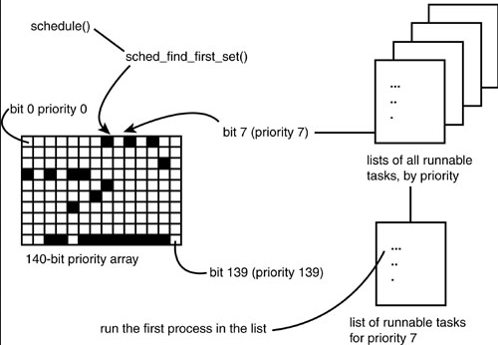

Slide 74
Basic Scheduling Algorithm
Find the highest-priority queue with a runnable process
Find the first process on that queue
Get its quantum size
Let it run
When its time is up, put it on the expired list
Recalculate priority/quantam first
Repeat

Slide 75
Runqueue for O(1) Scheduler
priority array
Higher priority more I/O
800ms quanta
priority queue
active
.
.
.
.
.
.
priority queue
lower priority more CPU
10ms quanta
expired
priority array
priority queue
.
.
.
.
.
.
priority queue

Slide 76
The Highest Priority Process
There is a bit map indicating which queues have processes that are ready to run
Find the first bit that’s set:
140 queues → 5 integers
Only a few compares to find the first that is non-zero
Hardware instruction to find the first 1-bit
bsfl on Intel
Time depends on the number of priority levels, not the number of processes

Slide 77
The Highest Priority Process

Slide 78
The Highest Priority Process
struct task_struct *prev, *next;
struct list_head *queue;
struct prio_array array;
int idx;
prev = current;
array = rq->active;
idx = sched_find_first_bit(array->bitmap);
queue = array->queue + idx;
next = list_entry(queue->next);

Slide 79
Swapping Arrays
struct prioarray *array =
rq->active;
if (array->nr_active == 0) {
rq->active = rq->expired;
rq->expired = array;
}

Slide 80
Runqueue
struct runqueue {
spinlock_t lock; /* spin lock which protects this runqueue */
unsigned long nr_running; /* number of runnable tasks */
unsigned long nr_switches; /* number of context switches */
unsigned long expired_timestamp; /* time of last array swap */
struct task_struct *curr; /* this processor's currently running task */
struct task_struct *idle; /* this processor's idle task */
struct mm_struct *prev_mm; /* mm_struct of last running task */
struct prio_array *active; /* pointer to the active priority array */
struct prio_array *expired; /* pointer to the expired priority array */
struct prio_array arrays[2]; /* the actual priority arrays */
int prev_cpu_load[NR_CPUS];/* load on each processor */
struct list_head *migration_queue; /* the migration queue for this processor */
atomic_t nr_iowait; /* number of tasks waiting on I/O */ }

Slide 81
Scheduler Runqueue
A scheduler runqueue is a list of tasks that are runnable on a particular CPU.
A rq structure maintains a linked list of those tasks.
The runqueues are maintained as an array runqueues, indexed by the CPU number.
The rq keeps a reference to its idle task
The idle task for a CPU is never on the scheduler runqueue for that CPU (it's always the last choice)
Access to a runqueue is serialized by acquiring and releasing rq->lock

Slide 82
Calculating Time Slices
time_slice in the task_struct
Calculate Quantum where
If (SP < 120): Quantum = (140 − SP) × 20
if (SP >= 120): Quantum = (140 − SP) × 5
where SP is the static priority
Higher priority process get longer quanta
Basic idea: important processes should run longer

Slide 83
Static Priority
Each task has a static priority that is set based upon the nice value specified by the task.
static_prio in task_struct
The nice value is in a range of -19 to 20, with the default value being 0. Only privileged tasks can set the nice value below 0.
For normal tasks, the static priority is base priority + the nice value.
Each task has a dynamic priority that is set based upon a number of factors

Slide 84
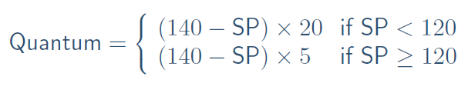
Nice Value vs. static priority and Quantum
 | Static Priority | NICE | Quantum
High Priority | 100 | -20 | 800 ms
 | 110 | -10 | 600 ms
 | 120 | 0 | 100 ms
 | 130 | +10 | 50 ms
Low Priority | 139 | +19 | 5 ms

Slide 85
Interactive Processes
A process is considered interactive if
bonus − 5 >= (Static Priority / 4) − 28
Low-priority processes have a hard time becoming interactive:
A high static priority (100) becomes interactive when its average sleep time is greater than 200 ms
A default static priority process becomes interactive when its sleep time is greater than 700 ms
Lowest priority (139) can never become interactive
The higher the bonus the task is getting and the higher its static priority, the more likely it is to be considered interactive.

Slide 86
Using Quanta
At every time tick (in scheduler_tick) , decrement the quantum of the current running process (time_slice)
If the time goes to zero, the process is done
Check interactive status:
If non-interactive, put it aside on the expired list
If interactive, put it at the end of the active list
Exceptions: don’t put on active list if:
If higher-priority process is on expired list
If expired task has been waiting more than STARVATION_LIMIT
If there’s nothing else at that priority, it will run again immediately
Of course, by running so much, its bonus will go down, and so will its priority and its interactive status

Slide 87
Avoiding Starvation
struct task_struct *task = current;
struct runqueue *rq = this_rq();
if (!—task->time_slice)
{ if (!TASK_INTERACTIVE(task) || EXPIRED_STARVING(rq))
enqueue_task(task, rq->expired);
else
enqueue_task(task, rq->active); }

Slide 88
Bonus, Sleep Average (I/O Wait)
Interactivity heuristic: sleep ratio
Mostly sleeping: I/O bound
Mostly running: CPU bound
Sleep ratio approximation
sleep_avg in the task_struct
Range: 0 .. MAX_SLEEP_AVG
When process wakes up (is made runnable), recalc_task_prio adds in how many ticks it was sleeping (blocked), up to some maximum value (MAX_SLEEP_AVG)
When process is switched out, schedule subtracts the number of ticks that a task actually ran (without blocking)
sleep_avg scaled to a bonus value

Slide 89
Average Sleep Time and Bonus Values
Average sleep time | Bonus
>= 0 but < 100 ms | 0
>= 100 ms but < 200 ms | 1
>= 200 ms but < 300 ms | 2
>= 300 ms but < 400 ms | 3
>= 400 ms but < 500 ms | 4
>= 500 ms but < 600 ms | 5
>= 600 ms but < 700 ms | 6
>= 700 ms but < 800 ms | 7
>= 800 ms but < 900 ms | 8
>= 900 ms but < 1000 ms | 9
1 second | 10

Slide 90
Multiprocessor Scheduling
Each processor has a separate run queue
Each processor only selects processes from its own queue to run
Yes, it’s possible for one processor to be idle while others have jobs waiting in their run queues
Periodically, the queues are rebalanced: if one processor’s run queue is too long, some processes are moved from it to another processor’s queue

Slide 91
Interprocess Communication
Processes within a system may be independent or cooperating
Cooperating process can affect or be affected by other processes, including sharing data
Cooperating processes need interprocess communication (IPC)
Two models of IPC
Shared memory
Message passing

Slide 92
Producer-Consumer Problem
Paradigm for cooperating processes, producer process produces information that is consumed by a consumer process
0
X
A
B
C
out
Consumer
1
Buffer empty=> in=out
Buffer full=>
(in+1)%size=out
2
3
4
in
Producer
5
unbounded-buffer places no practical limit on the size of the buffer
bounded-buffer assumes that there is a fixed buffer size

Slide 93
Bounded-Buffer – Shared-Memory Solution
Shared data
#define BUFFER_SIZE 10
typedef struct {
. . .
} item;
item buffer[BUFFER_SIZE];
int in = 0;
int out = 0;

Slide 94
Bounded-Buffer – Producer
while (true) { /* Produce an item */
while (((in + 1) % BUFFER SIZE) == out)
; /* do nothing -- no free buffers */
buffer[in] = item;
in = (in + 1) % BUFFER SIZE;
}

Slide 95
Bounded Buffer – Consumer
while (true) {
while (in == out)
; // do nothing -- nothing to consume
// remove an item from the buffer
item = buffer[out];
out = (out + 1) % BUFFER SIZE;
return item;
}

Slide 96
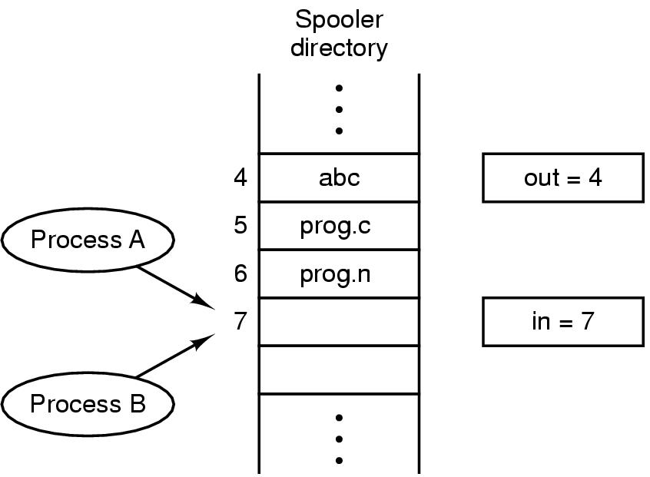
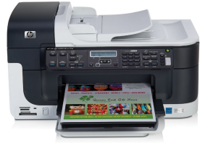
Interprocess Communication Race Conditions
Printer daemon
File 1
File 2
Two processes want to access shared memory at same time

Slide 97
Interprocess Communication Race Conditions
Process A
Next_free_slot=7
File 1
File 2
Two processes want to access shared memory at same time

Slide 98
Interprocess Communication Race Conditions
Process A
Next_free_slot=7
File 1
Process B
File 2
Next_free_slot=7
Two processes want to access shared memory at same time

Slide 99
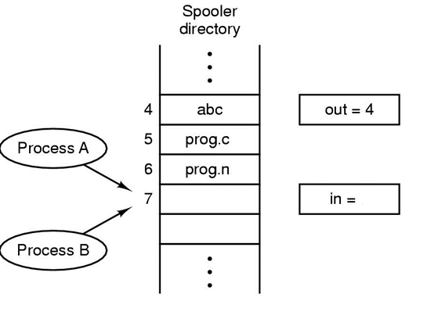
Interprocess Communication Race Conditions
Process A
Next_free_slot=7
File 1
File 2
8
Process B
Next_free_slot=8
Two processes want to access shared memory at same time

Slide 100
Interprocess Communication Race Conditions
Process A
Next_free_slot=8
File 1
File 1
8
Next_free_slot=8
Race condition
Two processes want to access shared memory at same time

Slide 101
Race condition
Race condition
Two or more processes are reading or writing some shared data and the final result depends on who runs precisely when
In our former example, the possibilities are various
Hard to debug

Slide 102
Critical Section Problem
Critical region
Part of the program where the shared memory is accessed
Mutual exclusion
Prohibit more than one process from reading and writing the shared data at the same time

Slide 103
Critical Section Problem
Consider system of n processes {p₀, p₁, … p_{n-1}}
Each process has critical section segment of code
Process may be changing common variables, updating table, writing file, etc
When one process in critical section, no other may be in its critical section
Critical section problem is to design protocol to solve this
Each process must ask permission to enter critical section in entry section, may follow critical section with exit section, then remainder section

Slide 104
Critical Section Problem
do {
entry section
critical section
exit section
remainder section
} while (TRUE);
General structure of a typical process P_{i}
104
Notes:
104

Slide 105
Solution to Critical-Section Problem
1. Mutual Exclusion - If process P_{i} is executing in its critical section, then no other processes can be executing in their critical sections
2. Progress –
If no process is executing in its critical section
and there exist some processes that wish to enter their critical section
then only the processes outside remainder section (i.e. the processes competing for critical section, or exit section) can participate in deciding which process will enter CS next
3. Bounded Waiting - A bound must exist on the number of times that other processes are allowed to enter their critical sections after a process has made a request to enter its critical section and before that request is granted
Assume that each process executes at a nonzero speed
No assumption concerning relative speed of the n processes

Slide 106
Critical Section Problem
do {
entry section
critical section
exit section
remainder section
} while (TRUE);
General structure of a typical process P_{i}
106
Notes:
106

Slide 107
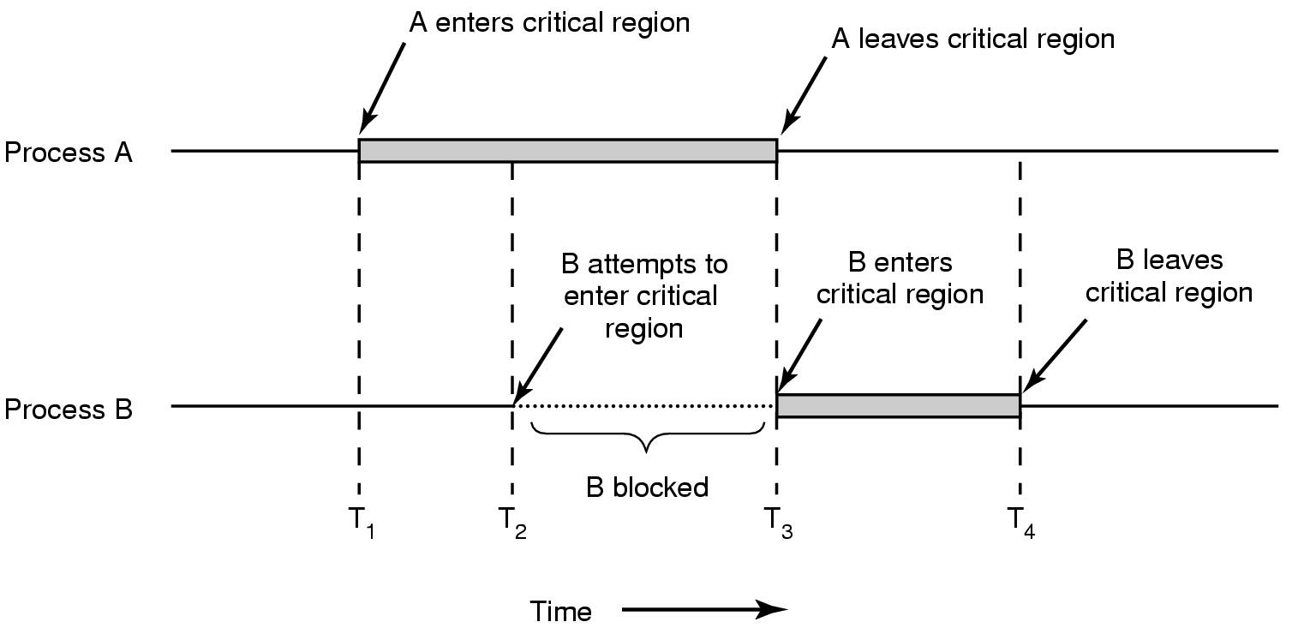
Critical Section Problem
Mutual exclusion using critical regions

Slide 108
Mutual Exclusion
Disable interrupt
After entering critical region, disable all interrupts
Since clock is just an interrupt, no CPU preemption can occur
Disabling interrupt is useful for OS itself, but not for users…

Slide 109
Mutual Exclusion with busy waiting
Lock variable
A software solution
A single, shared variable (lock)
before entering critical region, programs test the variable,
if 0, enter CS;
if 1, the critical region is occupied
What is the problem?
While(true)
{
while(lock!=0);
Lock=1
CS()
Lock=0
Non-CS()
}

Slide 110
Concepts
Busy waiting
Continuously testing a variable until some value appears
Spin lock
A lock using busy waiting is call a spin lock
CPU time wastage!

Slide 111
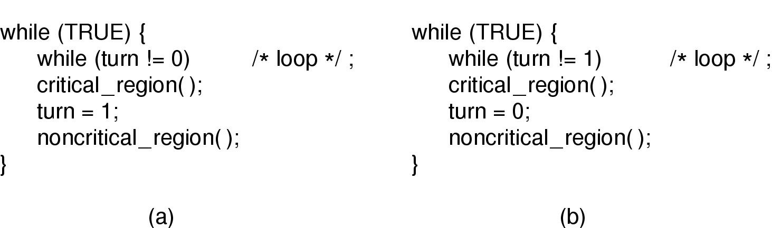
Mutual Exclusion with Busy Waiting : strict alternation
Proposed solution to critical region problem
(a) Process 0. (b) Process 1.

Slide 112
Peterson’s Solution
Two process solution
The two processes share two variables:
int turn;
Boolean interested [2]
The variable turn indicates whose turn it is to enter the critical section
The interested array is used to indicate if a process is interested to enter the critical section.
interested[i] = true implies that process P_{i} is interested!

Slide 113
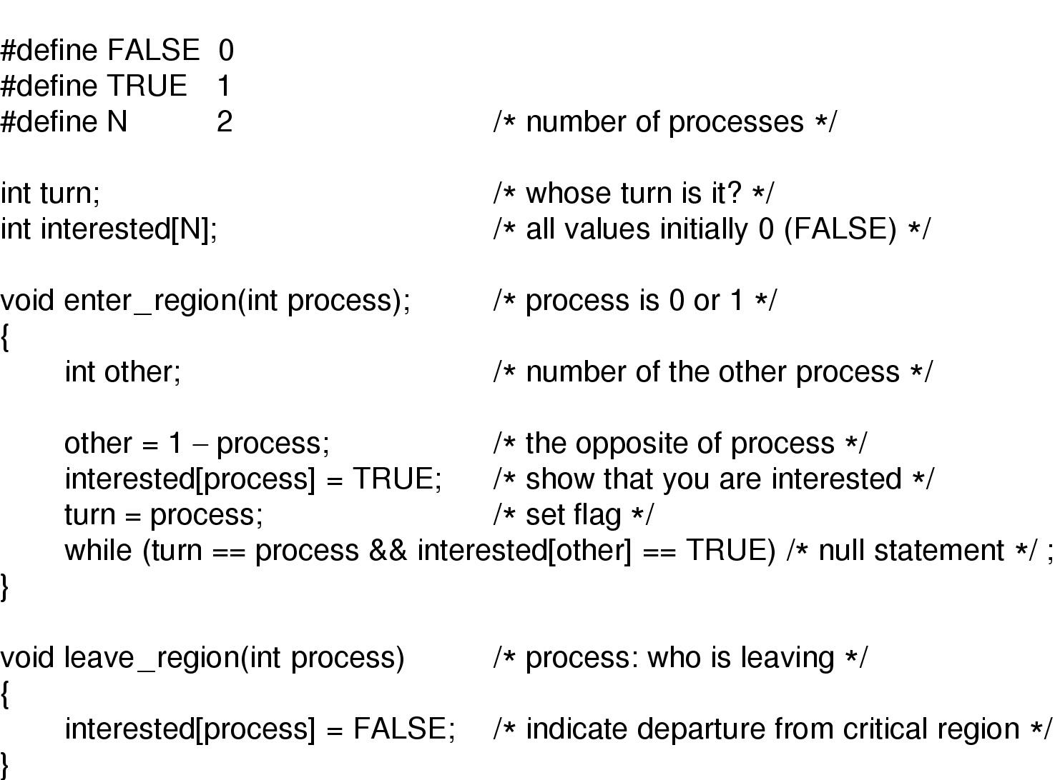
Mutual Exclusion with Busy Waiting (2) : a workable method
Peterson's solution for achieving mutual exclusion

Slide 114
Algorithm for Process P_{i}
do {
interested[i] = TRUE;
turn = j ;
while (interested[j] && turn == j);
critical section
interested[i] = FALSE;
remainder section
} while (TRUE);
Provable that
Mutual exclusion is preserved
Progress requirement is satisfied
Bounded-waiting requirement is met
Does this alter the sequence?

Slide 115
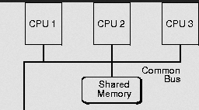
Hardware Instruction Based Solutions Multiprocessor system
Some architectures provide special instructions that can be used for synchronization
TSL: Test and modify the content of a word atomically
TSL Reg, lock
{
Reg= lock;
lock = true;
}

Slide 116
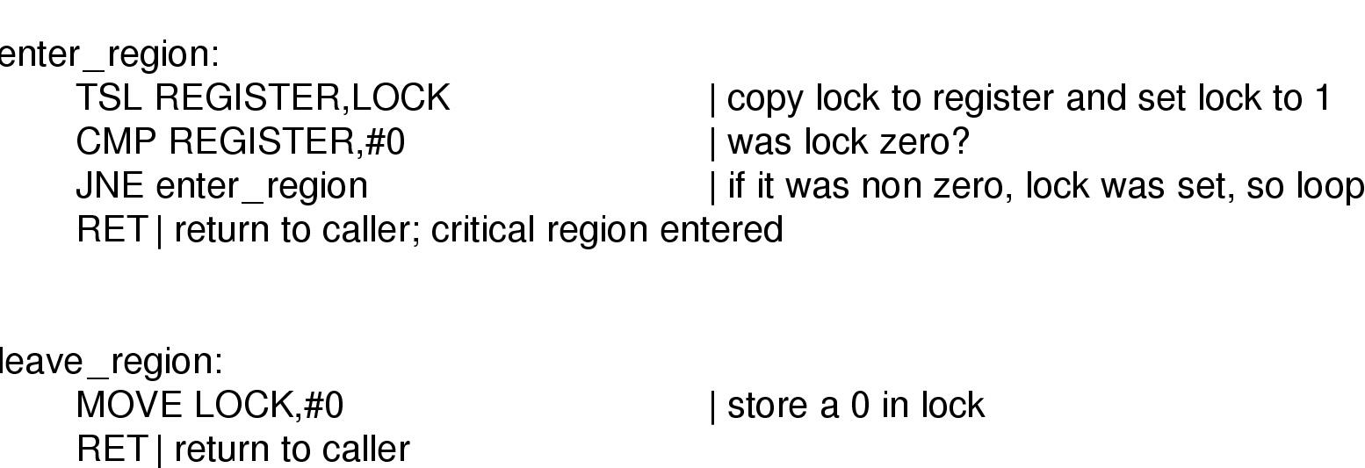
Hardware Instruction Based Solutions
Does it satisfy all the conditions?
Entering and leaving a critical region using the
TSL instruction

Slide 117
System call version
Special system call that can be used for synchronization
TestAndSet: Test and modify the content of a word atomically
boolean TestAndSet (boolean &target) {
boolean v = target;
target = true;
return v;
}

Slide 118
Mutual Exclusion with Test-and-Set
Shared data: boolean lock = false;
Process P_{i}
do {
while (TestAndSet(lock)) ;
critical section
lock = false;
remainder section
}
Does it satisfy all the conditions?

Slide 119
Swap Instruction
Definition:
void Swap (boolean *a, boolean *b)
{
boolean temp = *a;
*a = *b;
*b = temp:
}

Slide 120
Drawback of Busy waiting
A lower priority process has entered critical region
A higher priority process comes and preempts the lower priority process, it wastes CPU in busy waiting, while the lower priority don’t come out
Priority inversion problem

Slide 121
Producer-consumer problem
Two processes share a common, fixed-sized buffer
Producer puts information into the buffer
Consumer takes information from buffer
A simple solution

Slide 122
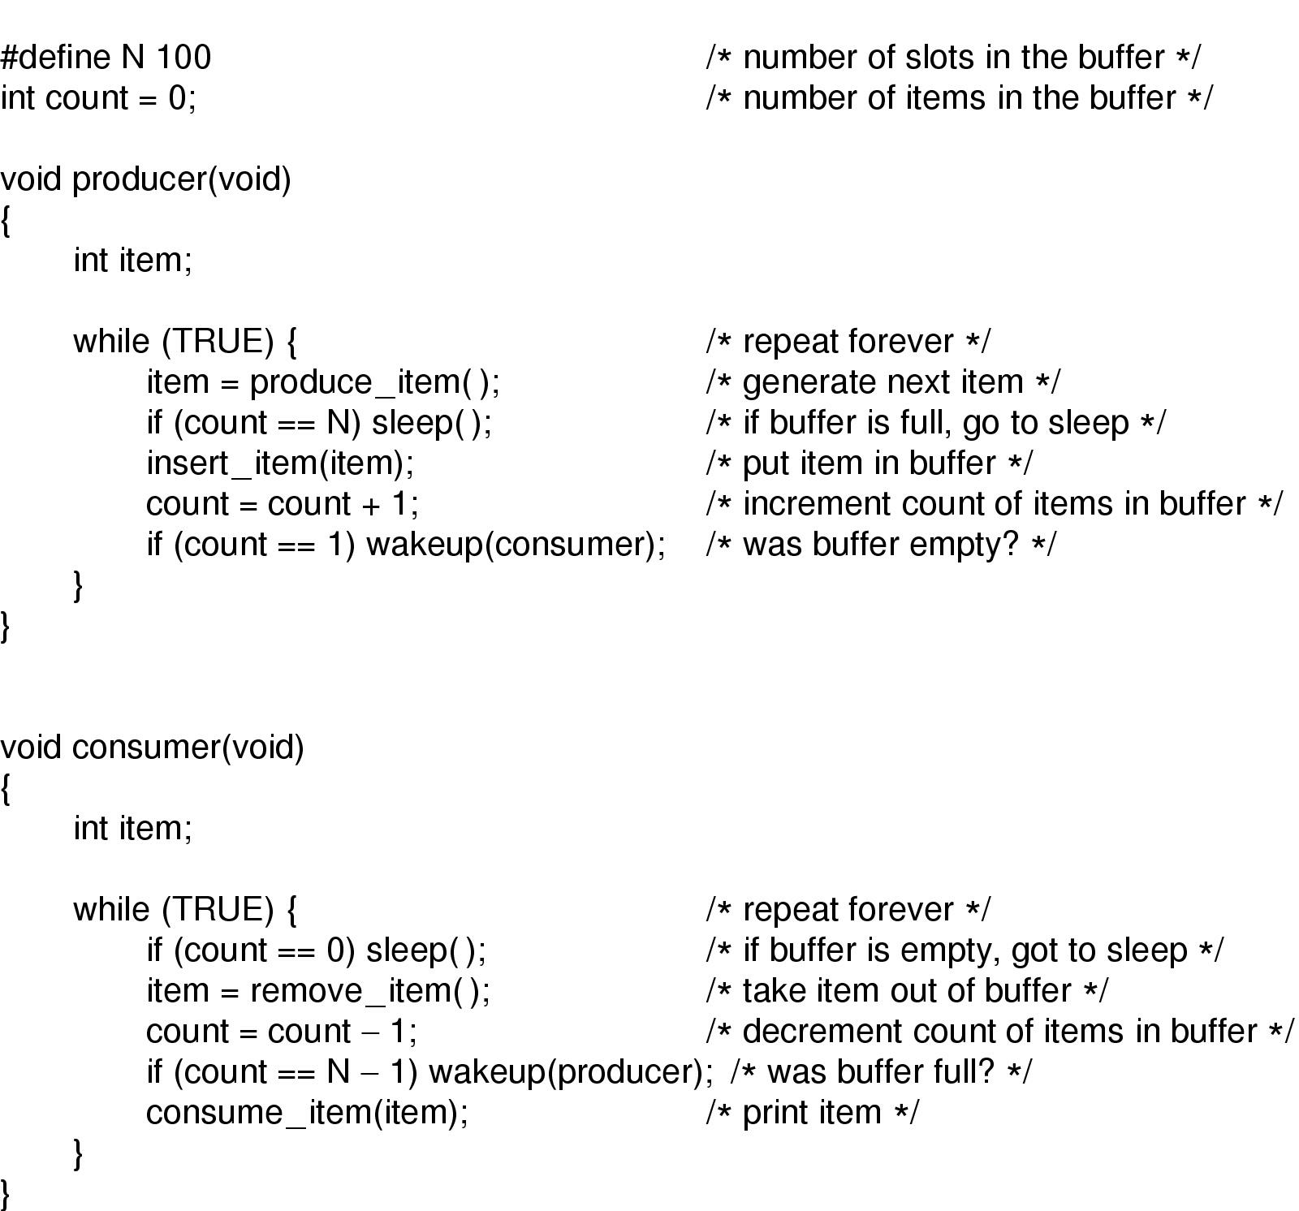
Sleep and Wakeup

Slide 123
Producer-Consumer Problem
What can be the problem?
Signal missing
Shared variable: counter
When consumer read count with a 0 but didn’t fall asleep in time
then the signal will be lost
Producer-consumer problem with fatal race condition

Slide 124
Tasks
We must ensure proper process synchronization
Stop the producer when buffer full
Stop the consumer when buffer empty
We must ensure mutual exclusion
Avoid race condition
Avoid busy waiting

Slide 125
Semaphore
Widely used synchronization tool
Does not require busy-waiting
CPU is not held unnecessarily while the process is waiting
A Semaphore S is
A data structure with an integer variable S.value and a queue S.list of processes (shared variable)
The data structure can only be accessed by two atomic operations, wait(S) and signal(S) (also called down(S), P(S) and Up(s), V(S))
Value of the semaphore S = value of the integer S.value
typedef struct {
int value;
struct process *list;
} semaphore

Slide 126
Semaphore
Wait(S) S<= semaphore variable
When a process P executes the wait(S) and finds
S==0
Process must wait => block()
Places the process into a waiting queue associated with S
Switch from running to waiting state
Signal(S)
When a process P executes the signal(S)
Check, if some other process Q is waiting on the semaphore S
Wakeup(Q)
Wakeup(Q) changes the process from waiting to ready state

Slide 127
Semaphore (wait and signal)
Implementation of wait:
wait(semaphore *S) {
S->value--;
if (S->value < 0) {
add this process to S->list;
block();
}
}
Implementation of signal:
signal(semaphore *S) {
S->value++;
if (S->value <= 0) {
remove a process P from S->list;
wakeup(P);
}
}
List of PCB
Atomic/ Indivisible
Note: which process is picked for unblocking may depend on policy.

Slide 128
Usage of Semaphore
Counting semaphore – integer value can range over an unrestricted domain
Control access to a shared resource with finite elements
Wish to use => wait(S)
Releases resource=>signal(S)
Used for synchronization
Binary semaphore – integer value can range only between 0 and 1
Also known as mutex locks
Used for mutual exclusion

Slide 129
Ordering Execution of Processes using Semaphores (Synchronization)
Execute statement B in P_{j} only after statement A executed in P_{i}
Use semaphore flag initialized to 0
Code:
P_{i} P_{j}
 
Stmt. A wait(flag)
signal(flag) Stmt. B
Multiple such points of synchronization can be enforced using one or more semaphores

Slide 130
Semaphore: Mutual exclusion
Shared data:
semaphore mutex; /* initially mutex = 1 */
Process P_{i}:
do { wait(mutex);
critical section
signal(mutex);
remainder section
} while (1);

Slide 131
Producer-consumer problem : Semaphore
Solve producer-consumer problem
Full: counting the slots that are full; initial value 0
Empty: counting the slots that are empty, initial value N
Mutex: prevent access the buffer at the same time, initial value 0 (binary semaphore)
Synchronization & mutual exclusion

Slide 132
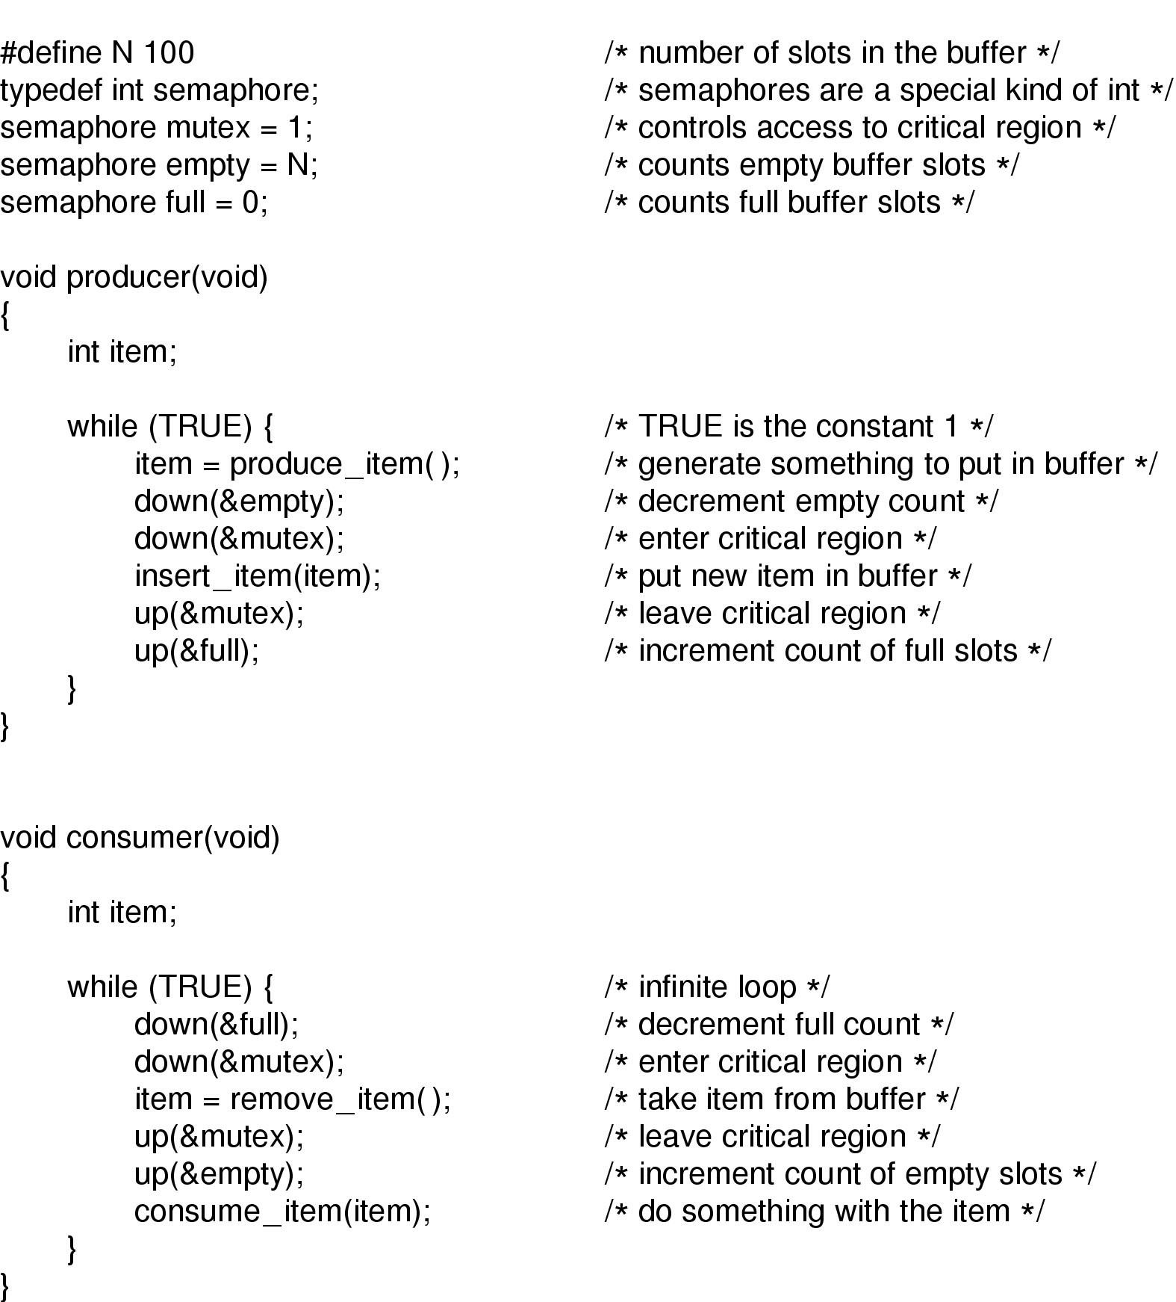
Semaphores

Slide 133
P₀ P₁
wait (S); wait (Q);
wait (Q); wait (S);
. .
. .
. .
signal (S); signal (Q);
signal (Q); signal (S);
Let S and Q be two semaphores initialized to 1

Slide 134
Deadlock and Starvation
Deadlock – two or more processes are waiting indefinitely for an event that can be caused by only one of the waiting processes
Let S and Q be two semaphores initialized to 1
P₀ P₁
wait (S); wait (Q);
wait (Q); wait (S);
. .
. .
. .
signal (S); signal (Q);
signal (Q); signal (S);
Starvation – indefinite blocking
LIFO queue
A process may never be removed from the semaphore queue in which it is suspended

Slide 135
Readers-Writers Problem
A database is shared among a number of concurrent processes
Readers – only read the data set; they do not perform any updates
Writers – can both read and write
Problem – allow multiple readers to read at the same time
Only one single writer can access the shared data at the same time
Several variations of how readers and writers are treated – all involve priorities
Shared Data
Database
Semaphore mutex initialized to 1
Semaphore wrt initialized to 1
Integer readcount initialized to 0

Slide 136
Readers-Writers Problem
Writer
R
R
R
Writer
Task of the writer
Just lock the dataset and write
Reader
Task of the first reader
Lock the dataset
Task of the last reader
Release the lock
Wakeup the any waiting writer
R
R
R

Slide 137
Readers-Writers Problem (Cont.)
The structure of a writer process
do {
wait (wrt) ;
// writing is performed
signal (wrt) ;
} while (TRUE);

Slide 138
Readers-Writers Problem (Cont.)
The structure of a reader process
do {
wait (mutex) ;
readcount ++ ;
if (readcount == 1)
wait (wrt) ;
signal (mutex)
// reading is performed
wait (mutex) ;
readcount - - ;
if (readcount == 0)
signal (wrt) ;
signal (mutex) ;
} while (TRUE);

Slide 139
Readers-Writers Problem (Cont.)
Models database access
Current solution
Reader gets priority over writer
Home work
Writer gets priority

Slide 140

Dining Philosophers Problem

Slide 141
Dining Philosophers Problem
First solution
Take_fork() waits until the fork is available
Available? Then seizes it
Ensure that two neighboring philosopher should not seize the same fork

Slide 142
Dining Philosophers Problem
Each fork is implemented as a semaphore
Semaphore fork [5] initialized to 1
The structure of Philosopher i:
do {
wait ( fork[i] );
wait ( fork[ (i + 1) % 5] );
// eat
signal ( fork[i] );
signal (fork[ (i + 1) % 5] );
// think
} while (TRUE);
What is the problem with this algorithm?
Ensures no two neighboring philosophers can eat simultaneously

Slide 143
Dining Philosophers Problem
First solution
Take_fork() waits until the fork is available
Available? Then seizes it
Suppose all of them take the left fork simultaneously
None of them will get the right fork
Deadlock

Slide 144
Dining Philosophers Problem
Second solution
After taking the left fork, philosopher checks to see if right fork is available
If not, puts down the left fork
Limitation
All of them start simultaneously, pick up the left forks
Seeing that their right forks are not available
Putting down their left fork
Starvation
Random delay (Exponential backoff) not going to help for critical systems

Slide 145
Dining Philosophers Problem
Third solution
Wait(mutex);
signal(mutex);
Poor resource utilization

Slide 146
Dining Philosophers Problem
Final solution
For each philosopher, maintain state and s
Thinking (0), Hungry (1), Eating (2)
Normal int array
state
semaphore array, initialized to 0
s
0 | 0 | 0 | 0 | 0 | 0 | 0 | 0
State takes care of acquiring the fork
s stops a philosopher from eating when fork is not available

Slide 147
Dining Philosophers Problem
Final solution
. . .

Slide 148
Dining Philosophers Problem
Final solution
. . .
. . .

Slide 149
Dining Philosophers Problem
Final solution
. . .

Slide 150
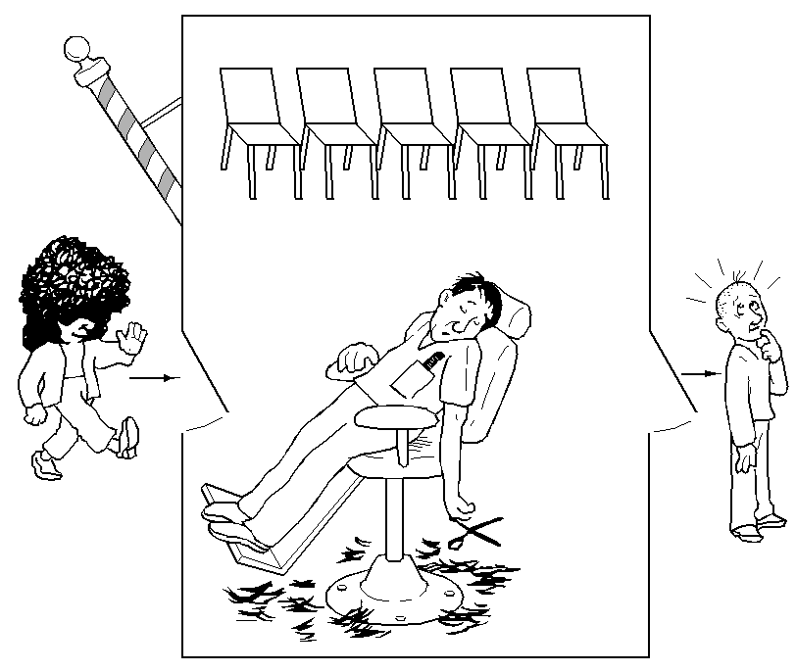
The Sleeping Barber Problem

Slide 151
Challenges
Actions taken by barber and customer takes unknown amount of time (checking waiting room, entering shop, taking waiting room chair)
Scenario 1
Customer arrives, observe that barber busy
Goes to waiting room
While he is on the way, barber finishes the haircut
Barber checks the waiting room
Since no one there, Barber sleeps
The customer reaches the waiting room and waits forever
Scenario 2
Two customer arrives at the same time
Barber is busy
Both customers try to occupy the same chair!

Slide 152
Barber sleeps on “Customer”
Customer sleeps on “Barber”
One semaphore: customer
No customer: Barber falls asleep
“I have arrived; waiting for your service”
Customer
Barber
Barber wakes up, if sleeping
One semaphore: barber
Customer acquires the Barber for service
“I am ready to give service to the next customer”
Barber
Customer
Customer waits if Barber busy

Slide 153
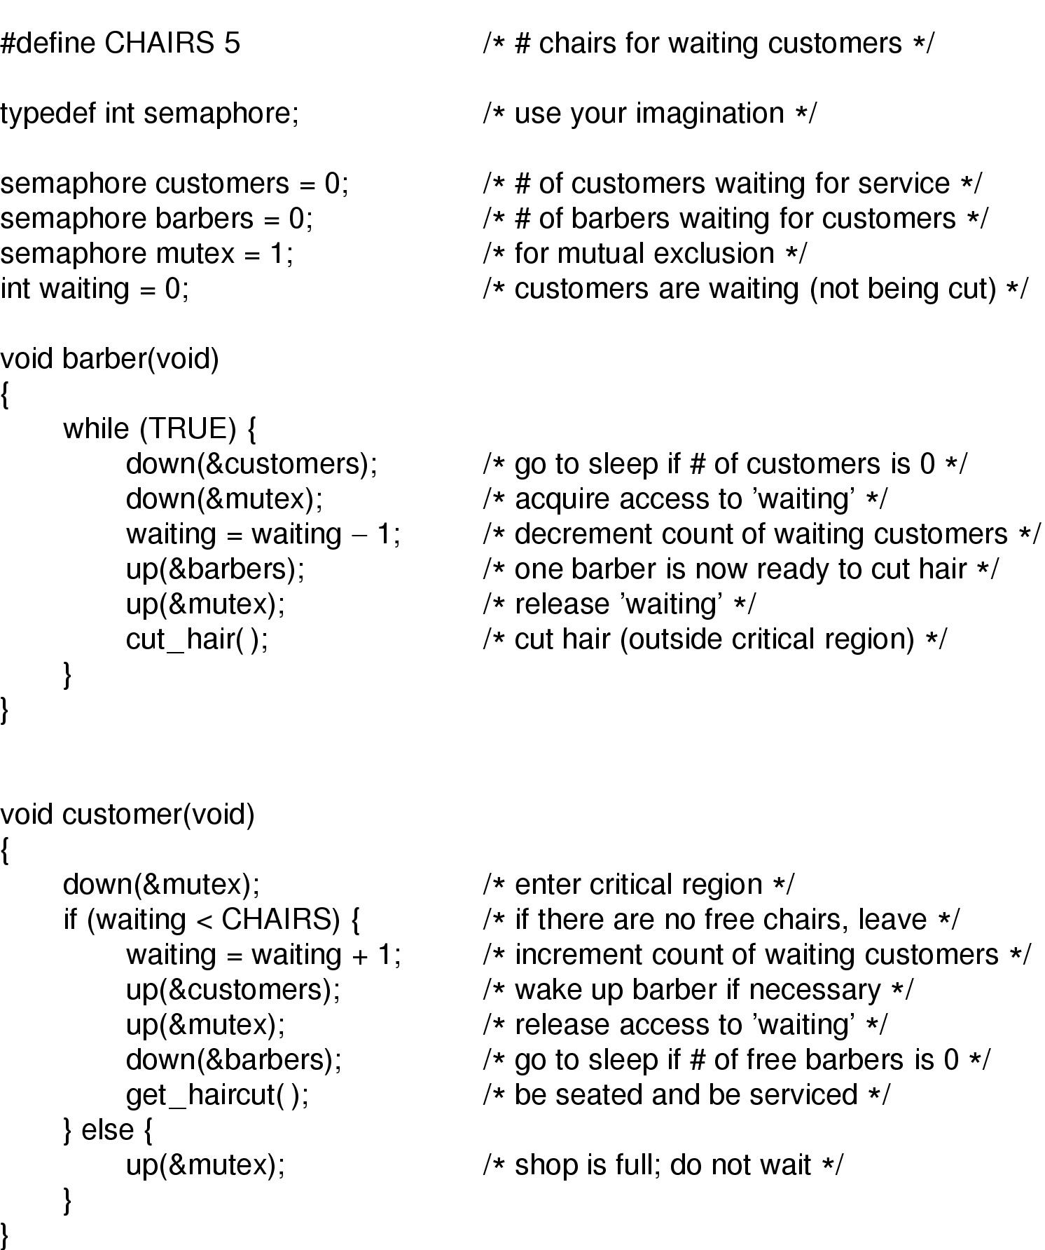
The Sleeping Barber Problem
Semaphore Barber: Used to call a waiting customer.
Barber=1: Barber is ready to cut hair and a customer is ready (to get service) too!
Barber=0: customer occupies barber or waits
Semaphore customer: Customer informs barber that “I have arrived; waiting for your service”
Mutex: Ensures that only one of the participants can change state at once

Slide 154
The Sleeping Barber Problem
Barber sleeps on “Customer”
Customer sleeps on “Barber”
For Barber: Checking the waiting room and calling the customer makes the critical section
For customer: Checking the waiting room and informing the barber makes its critical section

Slide 155
Deadlock

Slide 156
The Deadlock Problem
A set of blocked processes each holding a resource and waiting to acquire a resource held by another process in the set
Example
System has 2 disk drives
P₁ and P₂ each hold one disk drive and each needs another one
Example
semaphores A and B, initialized to 1
P₀ P₁
wait (A); wait (B);
wait(B) wait(A)

Slide 157
Introduction To Deadlocks
Deadlock can be defined formally as follows:
A set of processes is deadlocked if each process in the set is waiting for an event that only another process in the set can cause.

Slide 158
System Model
Resource types R₁, R₂, . . ., R_{m}
CPU cycles, memory space, I/O devices
Each resource type R_{i} has W_{i} instances.
Each process requests for an instance of a resource type
Each process utilizes a resource as follows:
request
use
release

Slide 159
Deadlock: necessary conditions
Deadlock can arise if four conditions hold simultaneously.
Mutual exclusion: only one process at a time can use a resource
Hold and wait: a process holding at least one resource is waiting to acquire additional resources held by other processes
No preemption: a resource can be released only voluntarily by the process holding it, after that process has completed its task
Circular wait: there exists a set {P₀, P₁, …, P_{n}} of waiting processes such that P₀ is waiting for a resource that is held by P₁, P₁ is waiting for a resource that is held by
P₂, …, P_{n–1} is waiting for a resource that is held by P_{n}, and P_{n} is waiting for a resource that is held by P₀.

Slide 160
Resource-Allocation Graph
A set of vertices V and a set of edges E.
V is partitioned into two types:
P = {P₁, P₂, …, P_{n}}, the set consisting of all the processes in the system
R = {R₁, R₂, …, R_{m}}, the set consisting of all resource types in the system
request edge – directed edge P_{i} → R_{j}
assignment edge – directed edge R_{j} → P_{i}

Slide 161
Resource-Allocation Graph (Cont.)
Process
Resource Type with 4 instances
P_{i} requests instance of R_{j}
P_{i} is holding an instance of R_{j}
P_{i}
R_{j}
P_{i}
R_{j}

Slide 162
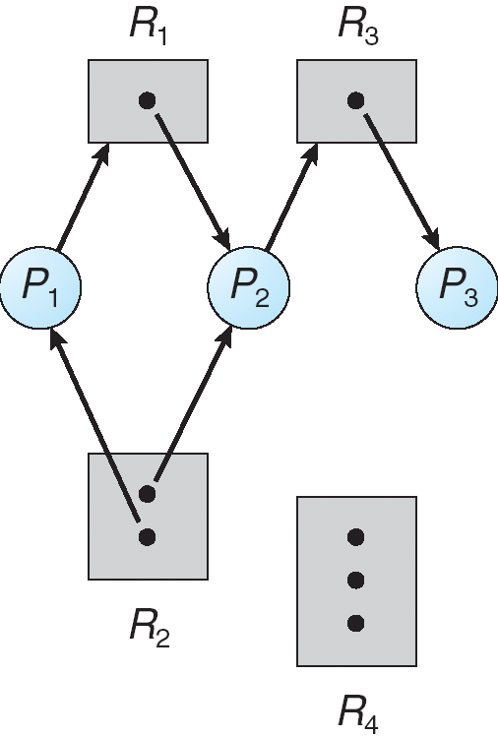
Example of a Resource Allocation Graph
No cycle; No deadlock

Slide 163
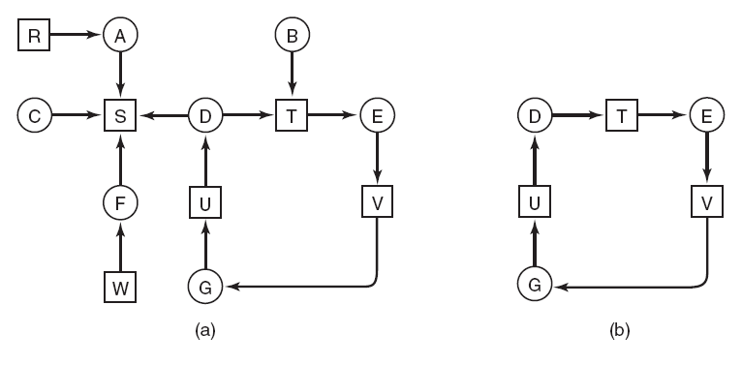
One Resource of Each Type
Figure 6-5. (a) A resource graph. (b) A cycle extracted from (a).
Contains Cycle; Deadlock

Slide 164
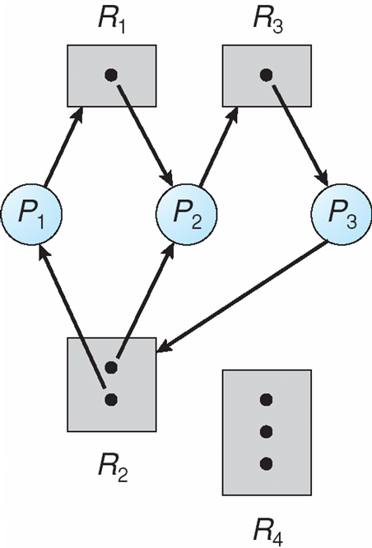
Resource Allocation Graph With A Deadlock
P₃ requests R₂

Slide 165
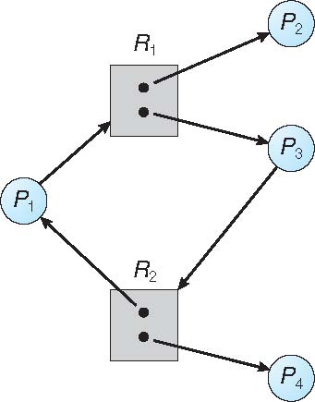
Graph With A Cycle But No Deadlock
P1->R1->P3->R2->P1

Slide 166
If the resource allocation graph does not have a cycle
System is not in a deadlocked state
If there is a cycle
May or may not be in a deadlocked state

Slide 167
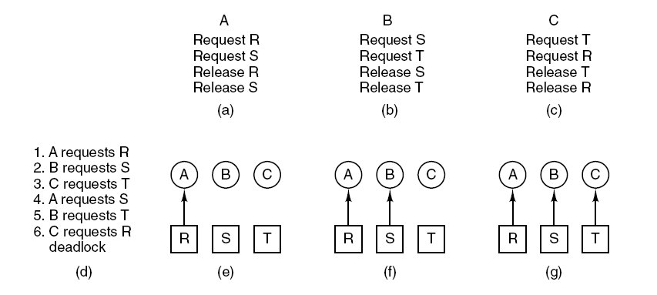
Deadlock Modeling
Figure 6-4. An example of how deadlock occurs and how it can be avoided.

Slide 168
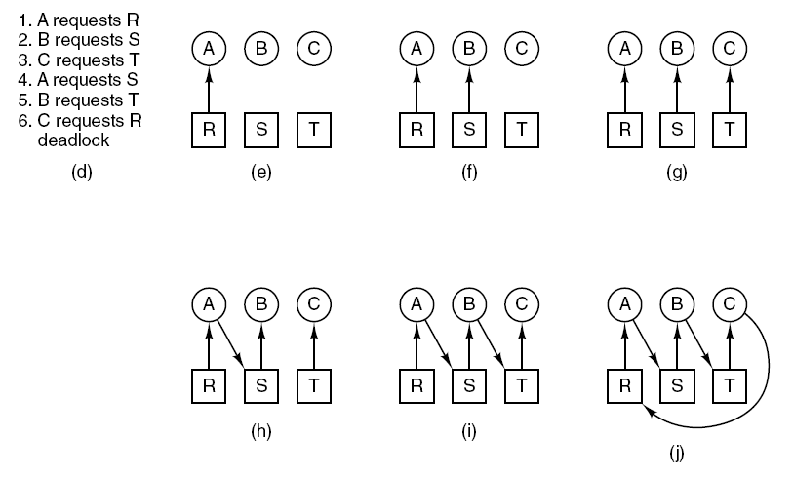
Deadlock Modeling
Figure 6-4. An example of how deadlock occurs and how it can be avoided.
Deadlock

Slide 169
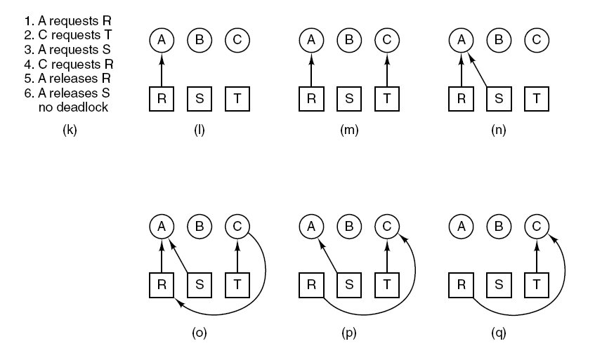
Deadlock Modeling
Figure 6-4. An example of how deadlock occurs and how it can be avoided.
Suspend process B

Slide 170
Deadlock Handling
Strategies for dealing with deadlocks:
Detection and recovery. Let deadlocks occur, detect them, take action.
Dynamic avoidance by careful resource allocation.
Prevention, by structurally negating one of the four required conditions.
Just ignore the problem.

Slide 171
Deadlock Detection
Allow system to enter deadlock state
Detection algorithm
Recovery scheme

Slide 172
Single Instance of Each Resource Type
In resource graph
P_{i} → R and R → P_{j}
Maintain wait-for graph
Nodes are processes
P_{i} → P_{j} if P_{i} is waiting for P_{j}
Periodically invoke an algorithm that searches for a cycle in the graph.
If there is a cycle, there exists a deadlock

Slide 173
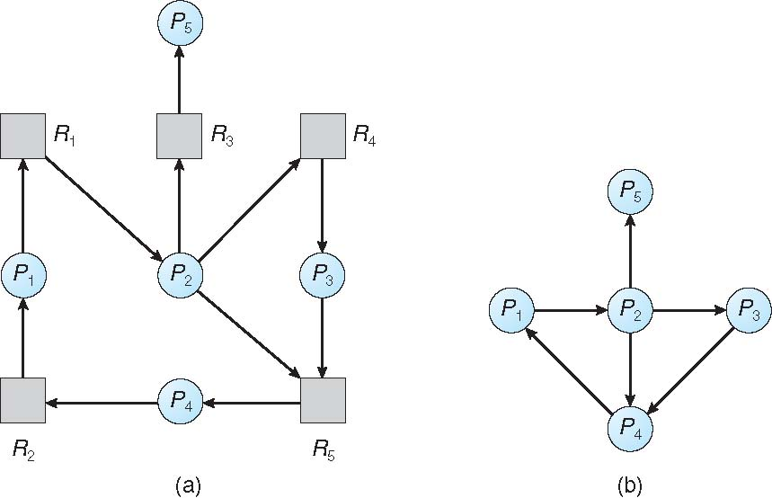
Resource-Allocation Graph and Wait-for Graph
Resource-Allocation Graph
Corresponding wait-for graph

Slide 174
Several Instances of a Resource Type
Let n = number of processes, and m = number of resources types.
Available: A vector of length m indicates the number of available resources of each type.
Allocation: An n x m matrix defines the number of resources of each type currently allocated to each process.
Request: An n x m matrix indicates the current request of each process. If Request [i][j] = k, then process P_{i} is requesting k more instances of resource type R_{j}.
R0 | R1 | R2 | R3
P₀
P₀
P₁
Allocation matrix
P₁
Request matrix
P₂
P₂
R₀
R₁
R₂
R₃
R₀
R₁
R₂
R₃

Slide 175
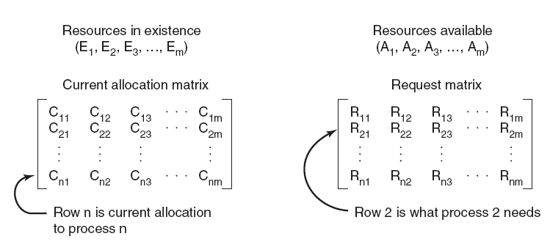
Several Instances of a Resource Type
Let n = number of processes, and m = number of resources types.
Figure 6-6. The four data structures needed by the deadlock detection algorithm.

Slide 176
Detection Algorithm
Define a relation ≤ over two vectors
X and Y are two vectors of length n
We say X ≤ Y
Iff X[i] ≤Y[i] for all i=1, 2, …, n

Slide 177
Detection Algorithm
Let Work and Finish be vectors of length m and n, respectively
Initialize:
(a) Work = Available
(b) For i = 1,2, …, n, if Allocation_{i} ≠ 0, then Finish[i] = false; otherwise, Finish[i] = true
2. Find an index i such that both:
(a) Finish[i] == false
(b) Request_{i} ≤ Work
If no such i exists, go to step 4

Slide 178
Detection Algorithm (Cont.)
3. Work = Work + Allocation_{i} Finish[i] = true go to step 2
4. If Finish[i] == false, for some i, 1 ≤ i ≤ n, then the system is in deadlock state. Moreover, if Finish[i] == false, then P_{i} is deadlocked

Slide 179
Example of Detection Algorithm
Five processes P₀ through P₄;
three resource types A (7 instances), B (2 instances), and C (6 instances)
Snapshot at time T₀:
Allocation Request Available
A B C A B C A B C
P₀ 0 1 0 0 0 0 0 0 0
P₁ 2 0 0 2 0 2
P₂ 3 0 3 0 0 0
P₃ 2 1 1 1 0 0
P₄ 0 0 2 0 0 2
Sequence <P₀, P₂, P₃, P₁, P₄> will result in Finish[i] = true for all i

Slide 180
Example (Cont.)
P₂ requests an additional instance of type C
Request
A B C
P₀ 0 0 0
P₁ 2 0 2
P₂ 0 0 1
P₃ 1 0 0
P₄ 0 0 2
State of system?
Can reclaim resources held by process P₀, but insufficient resources to fulfill other processes; requests
Deadlock exists, consisting of processes P₁, P₂, P₃, and P₄

Slide 181
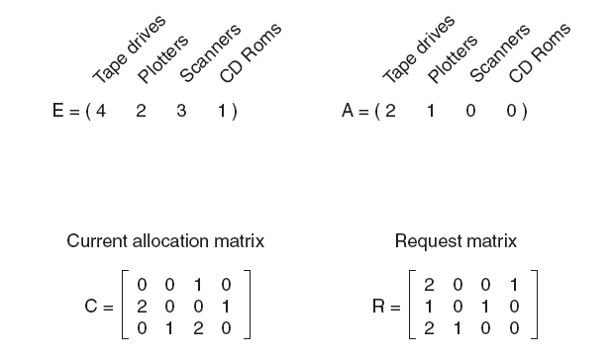
Home work
Available

Slide 182
Detection-Algorithm Usage
When, and how often, to invoke depends on:
How often a deadlock is likely to occur?
How many processes will be affected by deadlock?
If deadlock frequent
Invoke detection algo frequently
Invoke after each (waiting) resource request
Huge overhead
CPU utilization drops

Slide 183
Recovery from Deadlock: Process Termination
Abort all deadlocked processes
Expensive
Abort one process at a time until the deadlock cycle is eliminated
Overhead=> invoke detection algo
In which order should we choose to abort?
Priority of the process
How long process has computed
Resources the process has used
Resources process needs to complete
How many processes will need to be terminated
Is process interactive or batch?

Slide 184
Recovery from Deadlock: Resource Preemption
Selecting a victim – minimize cost
(# of resources holding, duration)
Rollback – return to some safe state, restart process from that state
Starvation – same process may always be picked as victim, include number of rollback in cost factor

Slide 185
Deadlock Avoidance
Requires that the system has some additional a priori information available
Simplest and most useful model requires that each process declare the maximum number of resources of each type that it may need
The deadlock-avoidance algorithm dynamically examines the resource-allocation state to ensure that there can never be a circular-wait condition
Resource-allocation state is defined by the number of available and allocated resources, and the maximum demands of the processes

Slide 186
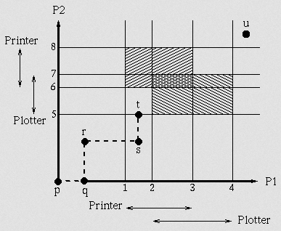
Safe State

Slide 187
Safe State
When a process requests an available resource, system must decide if immediate allocation leaves the system in a safe state
System is in safe state if there exists a sequence <P₁, P₂, …, P_{n}> of ALL the processes in the systems
such that for each P_{i}, the resources that P_{i} can still request can be satisfied by currently available resources + resources held by all the P_{j}, with j < i
That is:
If P_{i} resource needs are not immediately available, then P_{i} can wait until all P_{j} have finished
When P_{j} is finished, P_{i} can obtain needed resources, execute, return allocated resources, and terminate
When P_{i} terminates, P_{i +1} can obtain its needed resources, and so on

Slide 188
Basic Facts
If a system is in safe state ⇒ no deadlocks
If a system is in unsafe state ⇒ possibility of deadlock
Avoidance ⇒ ensure that a system will never enter an unsafe state.

Slide 189
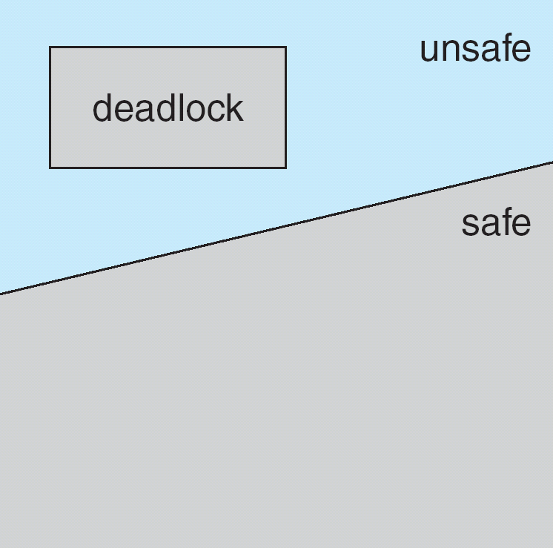
Safe, Unsafe, Deadlock State

Slide 190
Three processes P0, P1, P2
Resource R=12
State at time t₀
Maximum need Current allocation
P0 10 5
P1 4 2
P2 9 2
Free resource = 3
Safe sequence <P1, P0, P2> Safe state
State at time t₁
Allocate one resource to P2

Slide 191
Avoidance algorithms
Single instance of a resource type
Use a resource-allocation graph
Multiple instances of a resource type
Use the banker’s algorithm

Slide 192
Avoidance algorithms
Single instance of a resource type
Use a resource-allocation graph
Multiple instances of a resource type
Use the banker’s algorithm

Slide 193
Resource-Allocation Graph Scheme
Claim edge P_{i} → R_{j} indicated that process P_{j} may request resource R_{j}; represented by a dashed line
Claim edge converts to request edge when a process requests a resource
Request edge converted to an assignment edge when the resource is allocated to the process
When a resource is released by a process, assignment edge reconverts to a claim edge
Resources must be claimed a priori in the system

Slide 194

Resource-Allocation Graph
Request edge
Assignment edge
Claim edge

Slide 195

Unsafe State In Resource-Allocation Graph
Suppose that process P₂ requests a resource R₂

Slide 196
Resource-Allocation Graph Algorithm
Suppose that process P_{i} requests a resource R_{j}
The request can be granted only if converting the request edge to an assignment edge does not result in the formation of a cycle in the resource allocation graph
If no cycle
Safe state

Slide 197
Banker’s Algorithm
Multiple instances
Each process must a priori claim maximum use
When a process requests a set of resources
System decides whether the allocation is safe
When a process requests a resource
it may have to wait
When a process gets all its resources it must return them in a finite amount of time

Slide 198
Data Structures for the Banker’s Algorithm
Let n = number of processes, and m = number of resources types.
Available: Vector of length m. If available [j] = k, there are k instances of resource type R_{j} available
Max: n x m matrix. If Max [i,j] = k, then process P_{i} may request at most k instances of resource type R_{j}
Allocation: n x m matrix. If Allocation[i,j] = k then P_{i} is currently allocated k instances of R_{j}
Need: n x m matrix. If Need[i,j] = k, then P_{i} may need k more instances of R_{j} to complete its task
Need [i,j] = Max[i,j] – Allocation [i,j]

Slide 199
Several Instances of a Resource Type
Let n = number of processes, and m = number of resources types.
Available: A vector of length m indicates the number of available resources of each type.
Allocation: An n x m matrix defines the number of resources of each type currently allocated to each process.
R0 | R1 | R2 | R3
P₀
P₀
P₁
Allocation matrix
P₁
Max matrix
P₂
P₂
R₀
R₁
R₂
R₃
R₀
R₁
R₂
R₃

Slide 200
Deadlock avoidance : Flow chart for P_{i}
P_{i} requests resources
Take decision (safety algorithm)
Request_{i}[]
yes
Permanent allocation of resource
Provisionally allocate resources
State
Safe state?
New state
Temporary state (Request algorithm)
No
Restore the old state

Slide 201
Safety Algorithm
1. Let Work and Finish be vectors of length m and n, respectively. Initialize:
Work = Available
Finish [i] = false for i = 0, 1, …, n- 1
2. Find an i such that both:
(a) Finish [i] = false
(b) Need_{i} ≤ Work
If no such i exists, go to step 4
3. Work = Work + Allocation_{i} Finish[i] = true go to step 2
4. If Finish [i] == true for all i, then the system is in a safe state

Slide 202
Resource-Request Algorithm for Process P_{i}
Request = request vector for process P_{i}.
If Request_{i} [j] = k then process P_{i} wants k instances of resource type R_{j}
1. If Request_{i} ≤ Need_{i} go to step 2. Otherwise, raise error condition, since process has exceeded its maximum claim
2. If Request_{i} ≤ Available, go to step 3. Otherwise P_{i} must wait, since resources are not available
3. Pretend to allocate requested resources to P_{i} by modifying the state as follows:
Available = Available – Request_{i};
Allocation_{i} = Allocation_{i} + Request_{i};
Need_{i} = Need_{i} – Request_{i};
If safe ⇒ the resources are allocated to Pi
If unsafe ⇒ Pi must wait, and the old resource-allocation state is restored

Slide 203
Example of Banker’s Algorithm
5 processes P₀ through P₄;
3 resource types:
A (10 instances), B (5instances), and C (7 instances)
Snapshot at time T₀:
Allocation Max Available
A B C A B C A B C
P₀ 0 1 0 7 5 3 3 3 2
P₁ 2 0 0 3 2 2
P₂ 3 0 2 9 0 2
P₃ 2 1 1 2 2 2
P₄ 0 0 2 4 3 3

Slide 204
Example (Cont.)
The content of the matrix Need is defined to be Max – Allocation
Need
A B C
P₀ 7 4 3
P₁ 1 2 2
P₂ 6 0 0
P₃ 0 1 1
P₄ 4 3 1
Allocation Max Available
A B C A B C A B C
P₀ 0 1 0 7 5 3 3 3 2
P₁ 2 0 0 3 2 2
P₂ 3 0 2 9 0 2
P₃ 2 1 1 2 2 2
P₄ 0 0 2 4 3 3
The system is in a safe state since the sequence < P₁, P₃, P₄, P₂, P₀> satisfies safety criteria

Slide 205
Example (Cont.)
The content of the matrix Need is defined to be Max – Allocation
Need
A B C
P₀ 7 4 3
P₁ 1 2 2
P₂ 6 0 0
P₃ 0 1 1
P₄ 4 3 1
The system is in a safe state since the sequence < P₁, P₃, P₄, P₂, P₀> satisfies safety criteria

Slide 206
Example: P₁ Request (1,0,2)
Check that Request ≤ Available (that is, (1,0,2) ≤ (3,3,2) ⇒ true
Allocation Need Available
A B C A B C A B C
P₀ 0 1 0 7 4 3 2 3 0
P₁ 3 0 2 0 2 0
P₂ 3 0 2 6 0 0
P₃ 2 1 1 0 1 1
P₄ 0 0 2 4 3 1
Executing safety algorithm shows that sequence < P₁, P₃, P₄, P₀, P₂> satisfies safety requirement
Can request for (3,3,0) by P₄ be granted?
Can request for (0,2,0) by P₀ be granted?

Slide 207
Deadlock Handling
Strategies for dealing with deadlocks:
Detection and recovery. Let deadlocks occur, detect them, take action.
Dynamic avoidance by careful resource allocation.
Prevention, by structurally negating one of the four required conditions.
Just ignore the problem.

Slide 208
Deadlock Prevention
Restrain the ways request can be made
Mutual Exclusion – not required for sharable resources; must hold for nonsharable resources
Read only file
Hold and Wait – must guarantee that whenever a process requests a resource, it does not hold any other resources
Require process to request and be allocated all its resources before it begins execution,
Allow process to request resources only when the process has none
Release all the current resource and then try to acquire
Low resource utilization; starvation possible

Slide 209
Deadlock Prevention (Cont.)
No Preemption –
If a process that is holding some resources,
Requests another resource that cannot be immediately allocated to it
Resources were allocated to some waiting process
Preempt the desired resource from waiting process
Allocate to current process
Circular Wait – Impose a total ordering of all resource types
Require that each process requests resources in an increasing order of enumeration

Slide 210
Let R={R1, R2,……,Rm} set of resource type
We assign unique integer with each type
One to one function F:R→N
F(tape drive)=1
F(disk)=5
F(printer)=12
Protocol: Each process can request resource only in an increasing order.
Initially request R_{i}, after that, it can request R_{j}
If and only if F(R_{j})>F(R_{i})
Currently holding R_{j;} Want to request R_{i}.
Must have released R_{j}

Slide 211
F(R0) < F(R1)
R0
R1
R(n-1)
R(n)
P0
P1
P(n-1)
Pn
F(R0) < F(R1) < F(R2) <…………………< F(Rn) < F(R0)

